Slide 1
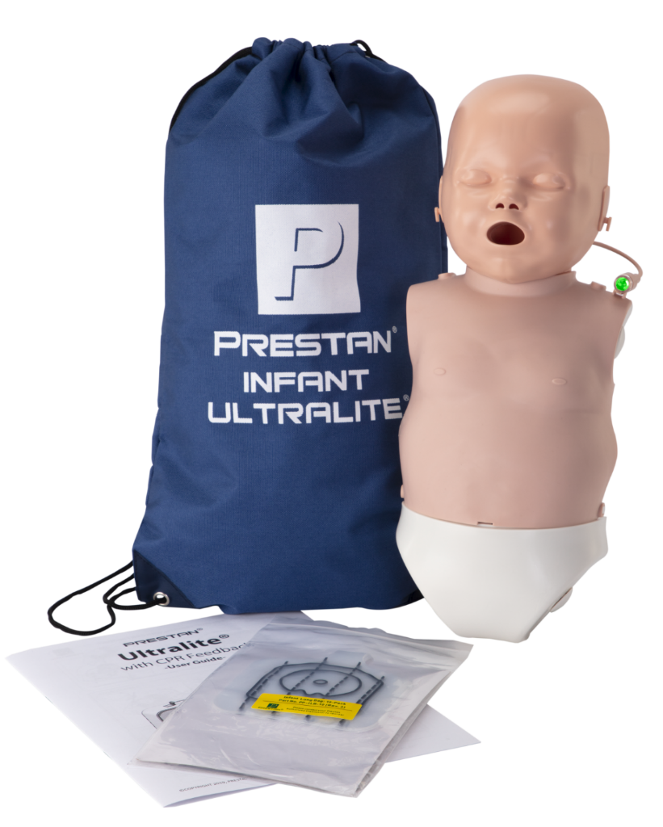
PRESTAN Infant Ultralite® – Description Details
When listing the product in print & digital marketing assets, please reference the PRESTAN Website, Marketing Site, and the following guidelines:
Product Name
PRESTAN Infant Ultralite® Manikin
Description
The PRESTAN Infant Ultralite Manikin is our most portable manikin, easy to transport & ship and simple to setup, use & clean.
Available with CPR Feedback only, in convenient and lightweight Single, 4-pack and 12-packs for efficient training on-the-go. This durable manikin offers an affordable method for CPR training, with all the quality and realism you expect from PRESTAN.
Fully compliant with current industry guidelines, including the most recent AHA Integrated Feedback Directive.
Available in medium or dark skin tones and in Single, 4-Pack or 12-Pack configurations; Diversity Kits also available.
Warranty
3yr Limited Warranty

