Slide 1
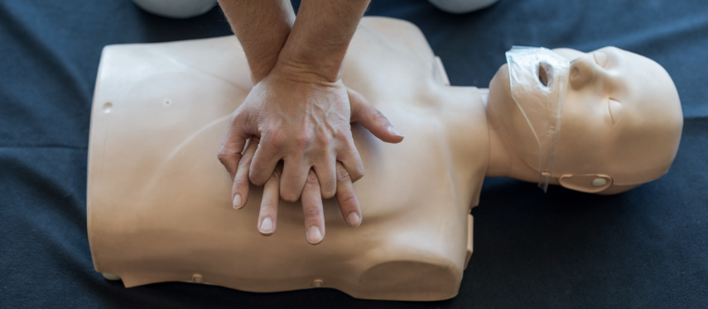
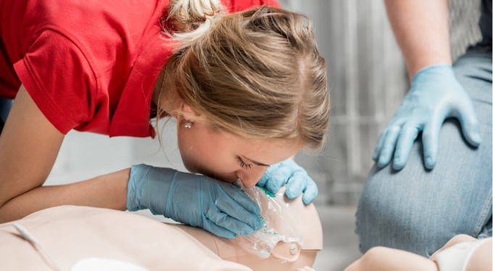
Building Confidence
with PRESTAN Professional Manikins
[DATE]
[NAME, TITLE]

Slide 2
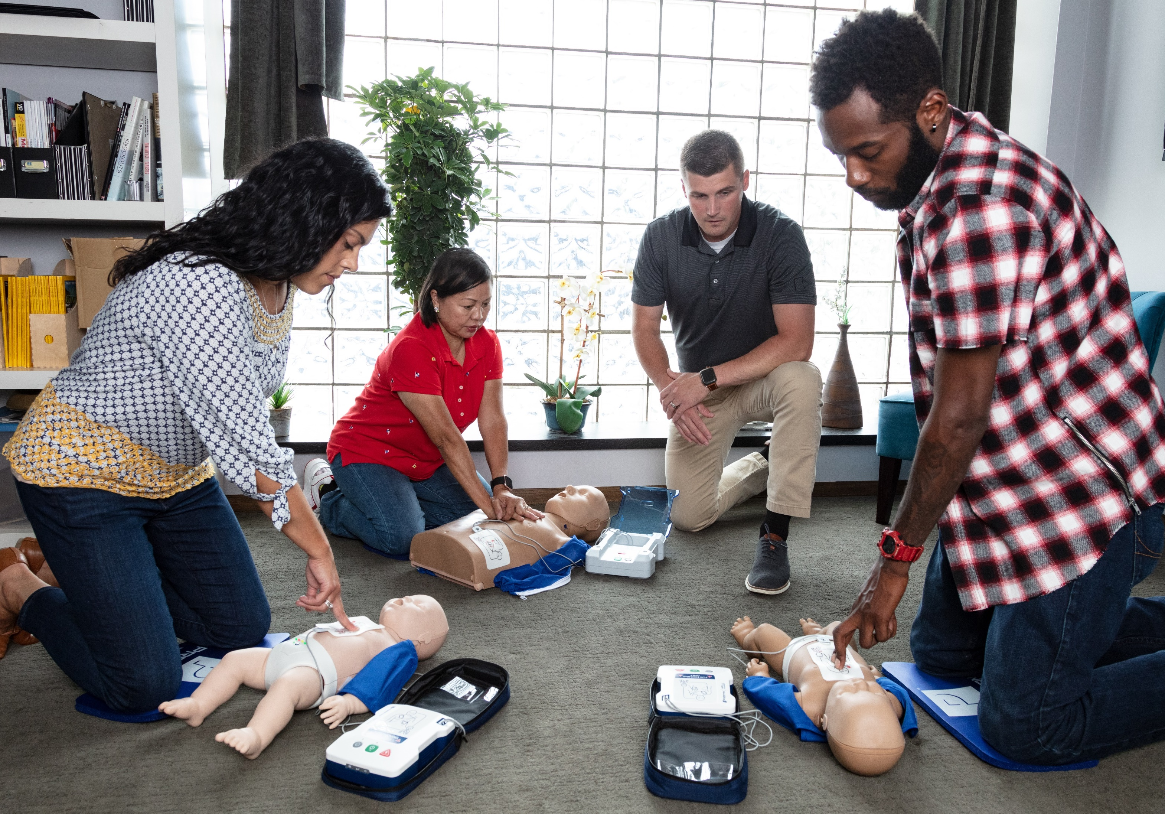
Agenda
Introduction
Key Product Features
Product Demo
Training Resources
Q&A

Slide 3
Introduction

Slide 4
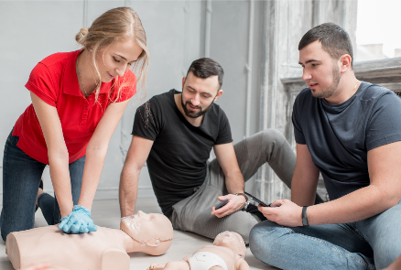
PRESTAN is Committed to Building Confidence…
with Students
realistic CPR manikin designs that provide immediate feedback
AED features that provide the most accurate representation of how live AED’s perform
with Instructors
high quality CPR manikins and AED trainers
easy to setup & clean, compact & lightweight to carry
provide immediate feedback to students
with Distributors
long term investment in new product development
high quality CPR & AED training products backed by industry leading 3-year warranty

Slide 5
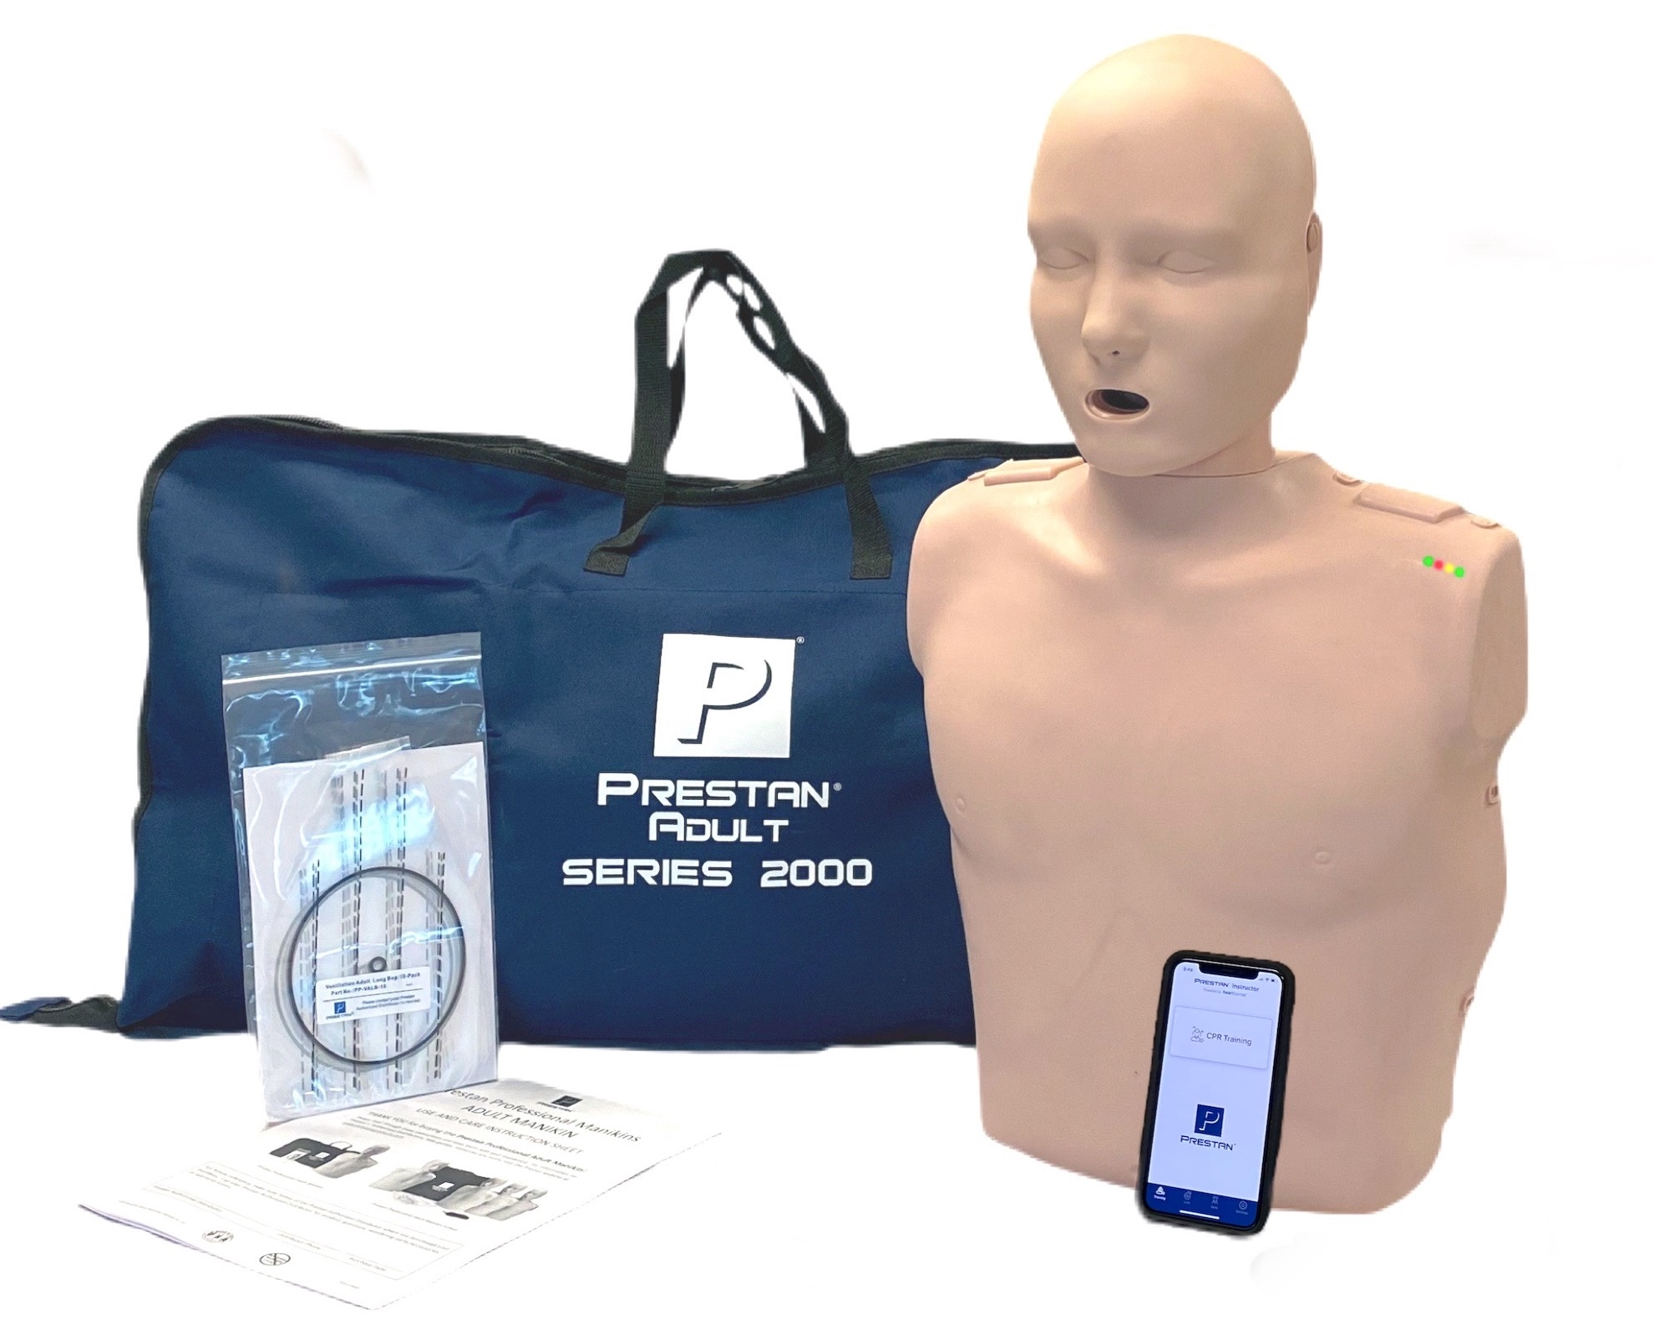
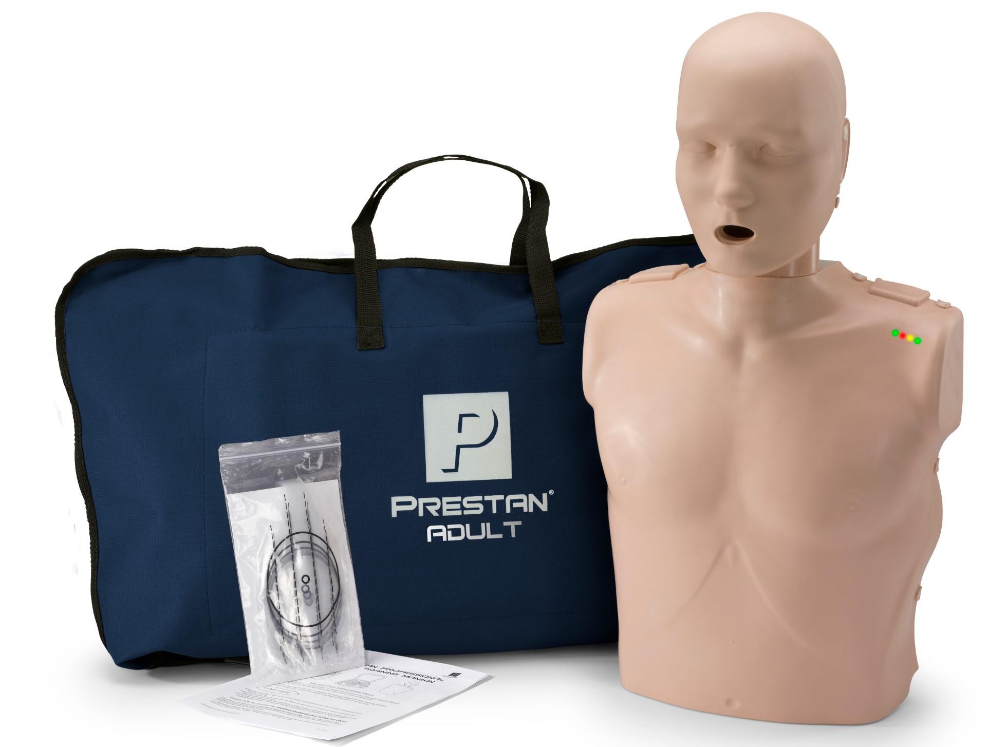
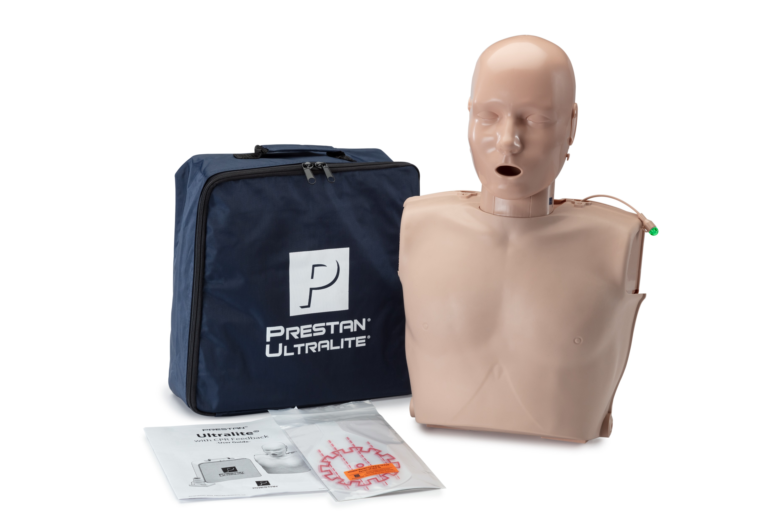
CPR Training Manikin Product Positioning
Features & Benefits
*Mobile device not included
PRESTAN Professional
Adult Series 2000
PRESTAN Professional
Adult & Jaw Thrust
PRESTAN Ultralite®
Basic CPR Training
Advanced CPR Training

Slide 6
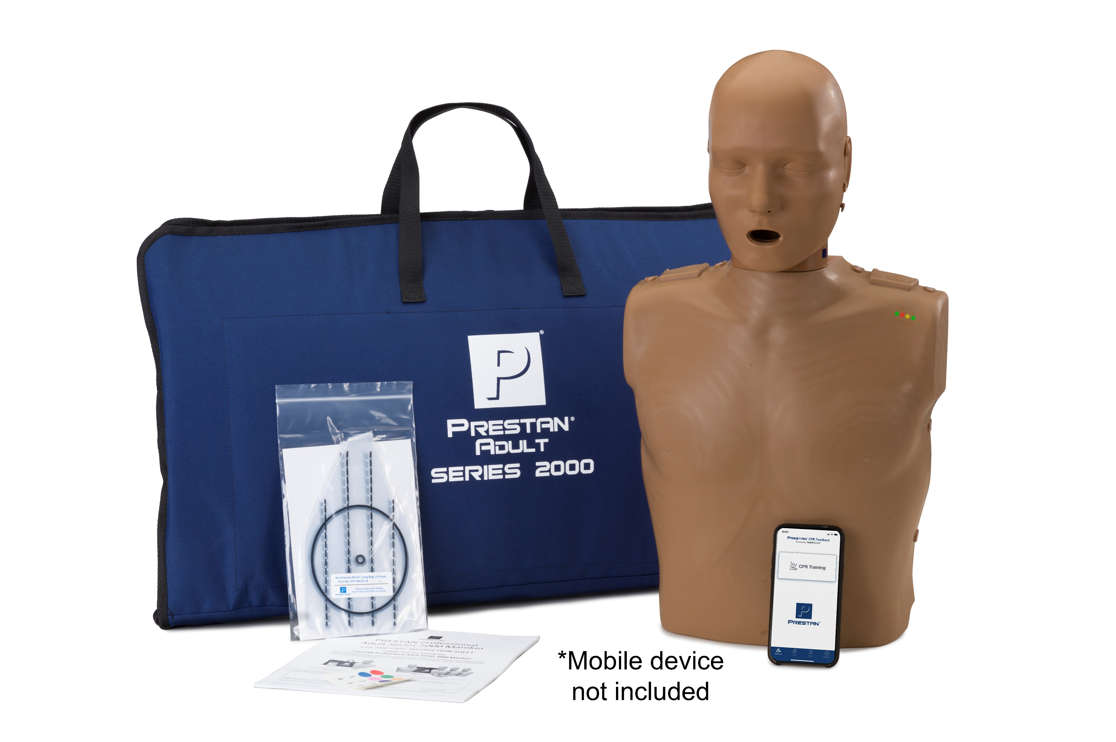
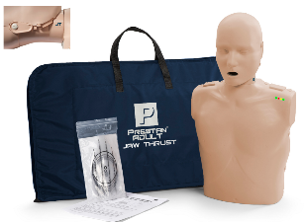
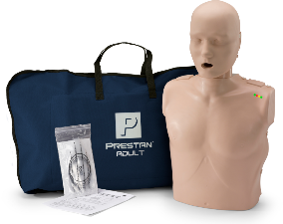
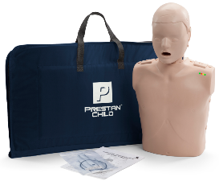
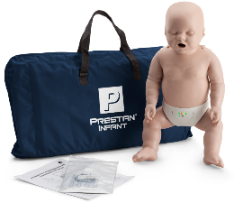
Professional Manikin Product Offerings
Professional Adult Series 2000
Professional Adult
Professional Adult Jaw Thrust
N
Professional Child
Professional Infant

Slide 7
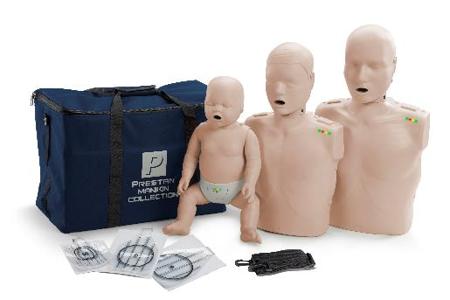
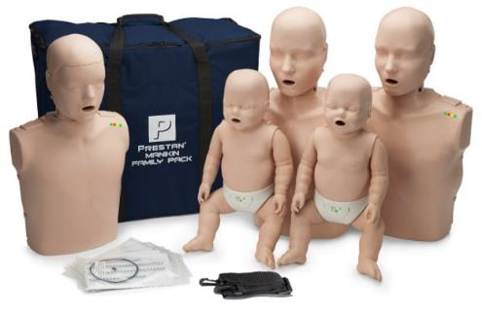
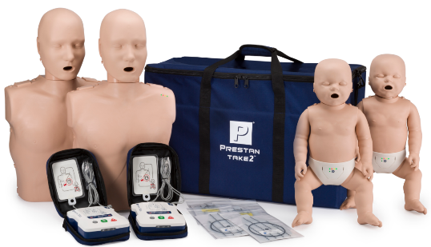
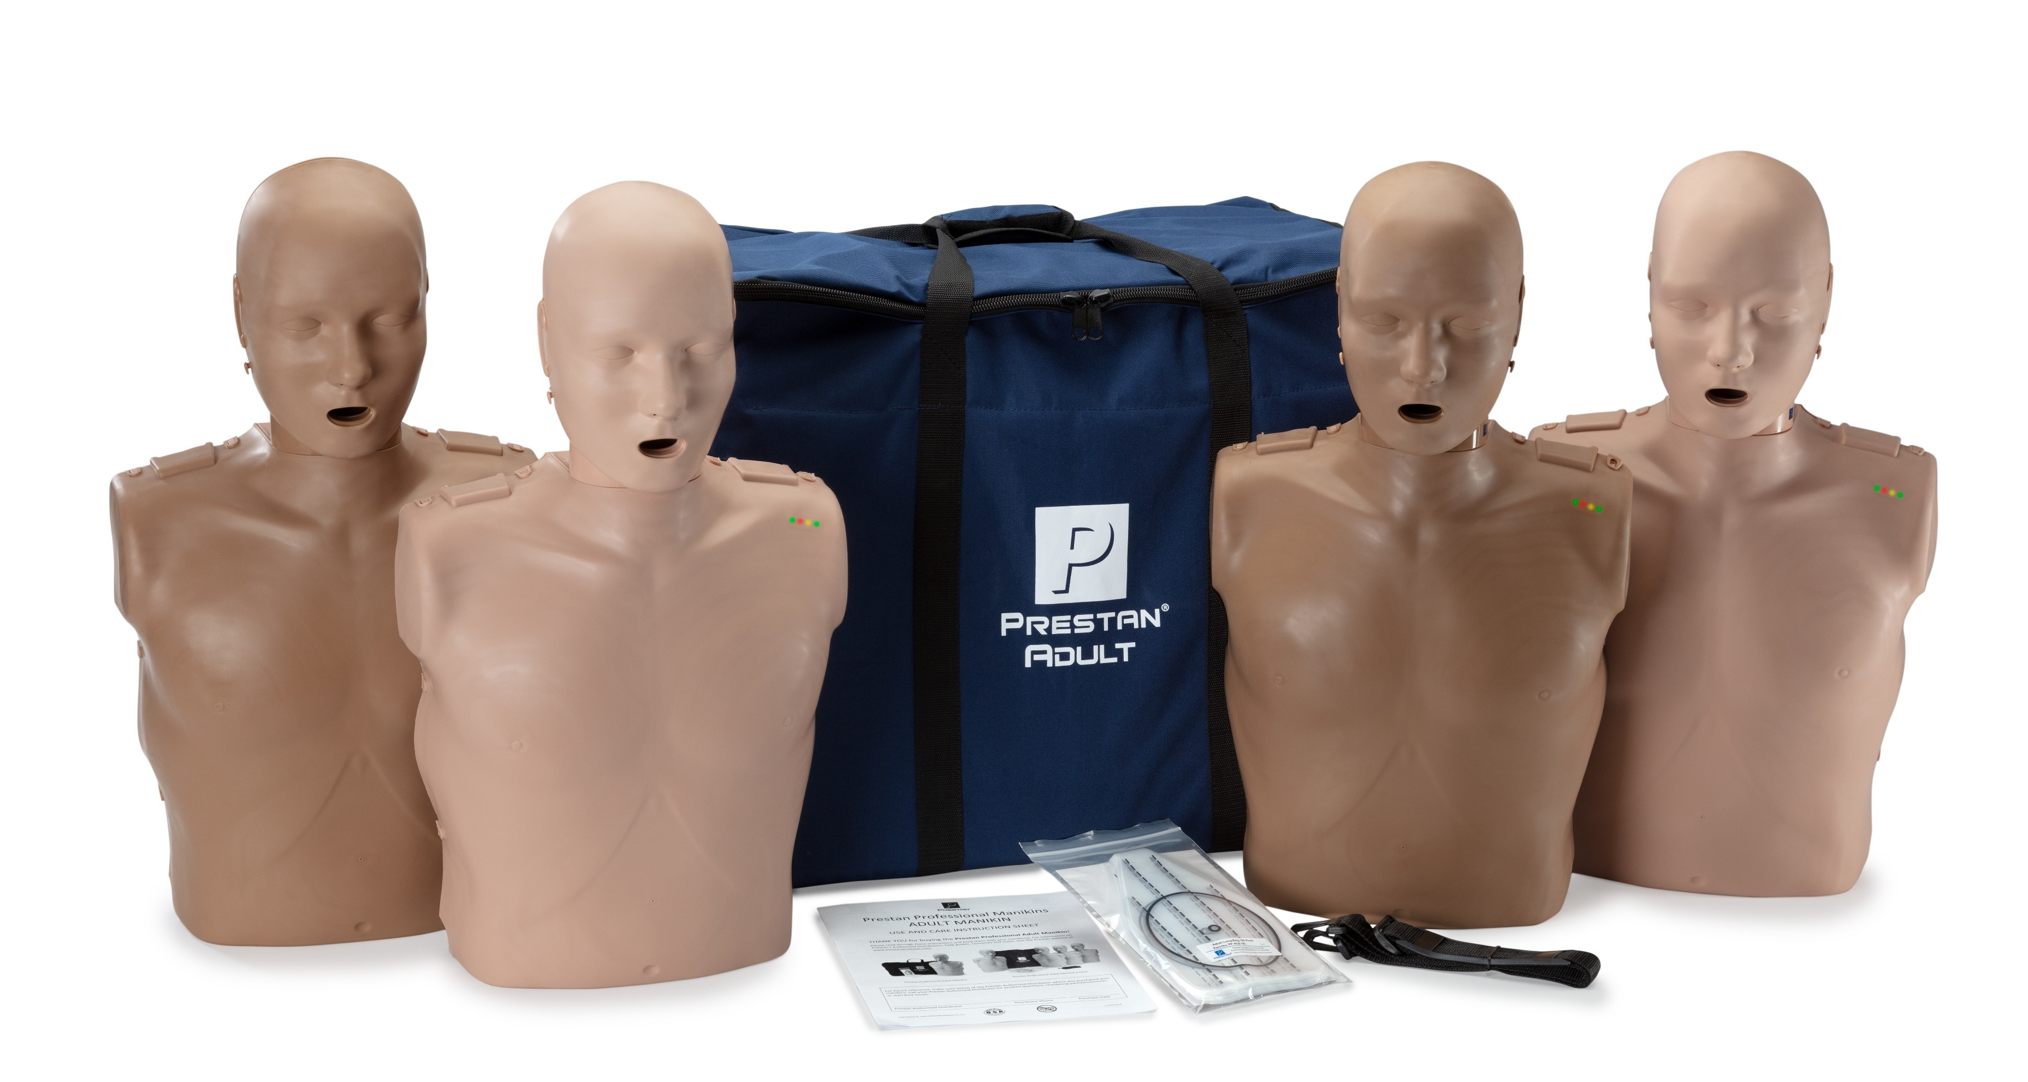
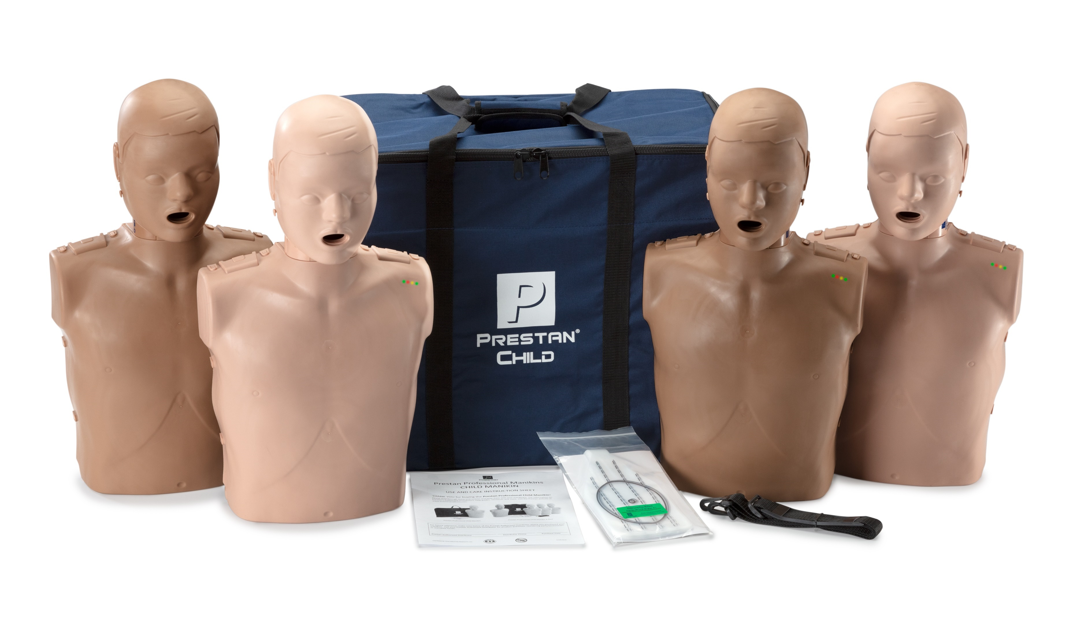
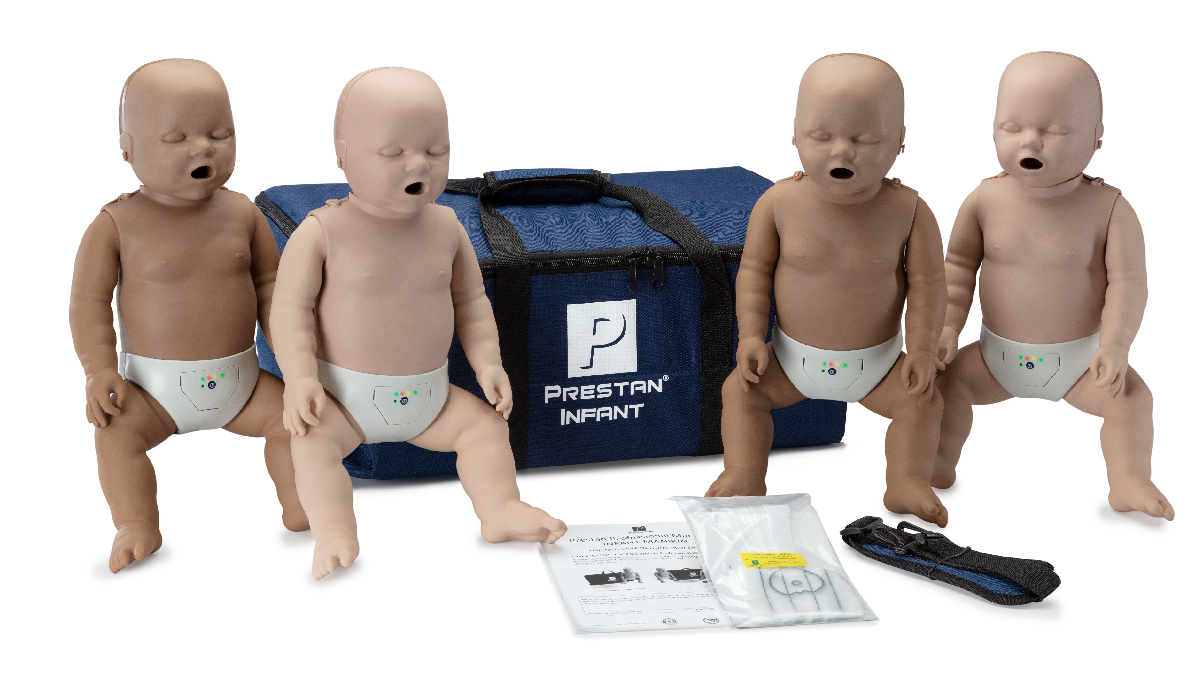
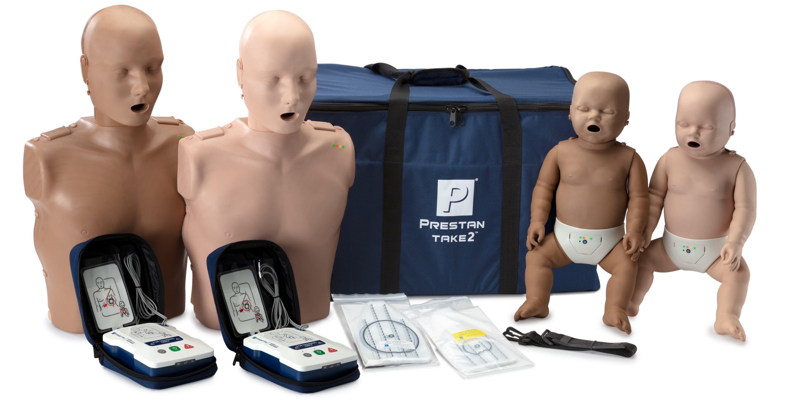
Professional Manikin Specialty Packs
PRESTAN Collection
PRESTAN Family Pack
PRESTAN TAKE2® Collection
Professional Adult, Child, Infant and TAKE2® Diversity Kits

Slide 8
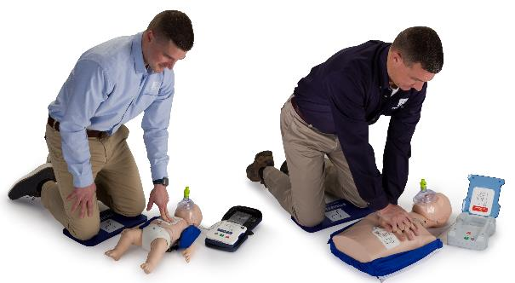
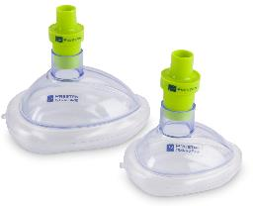
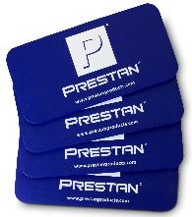
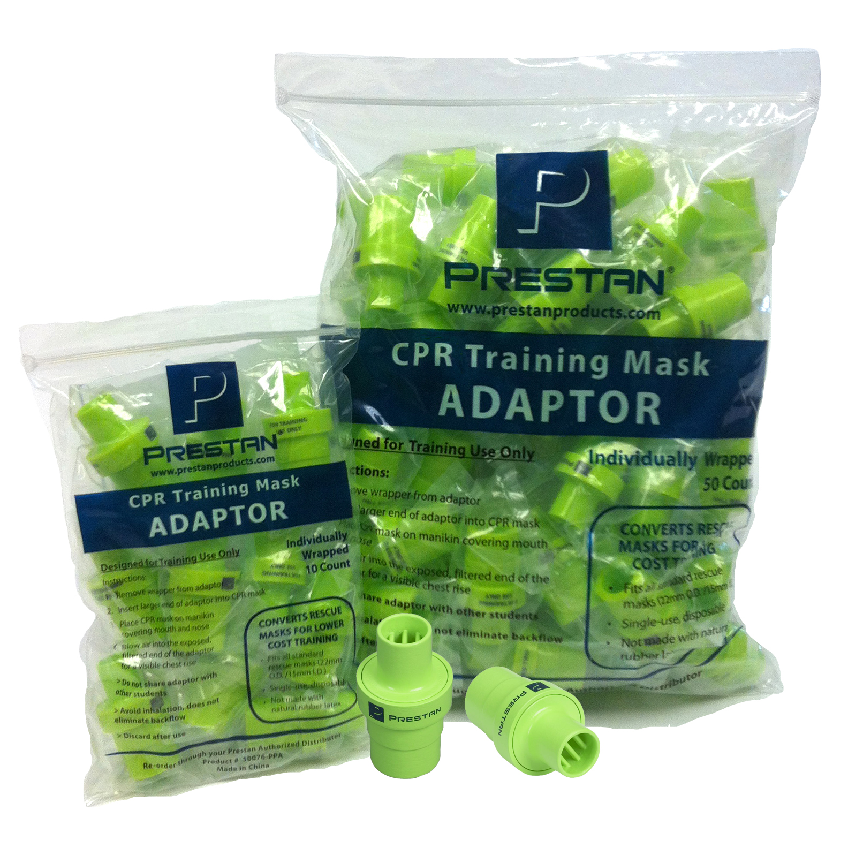
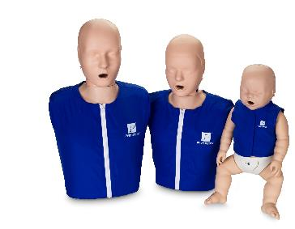
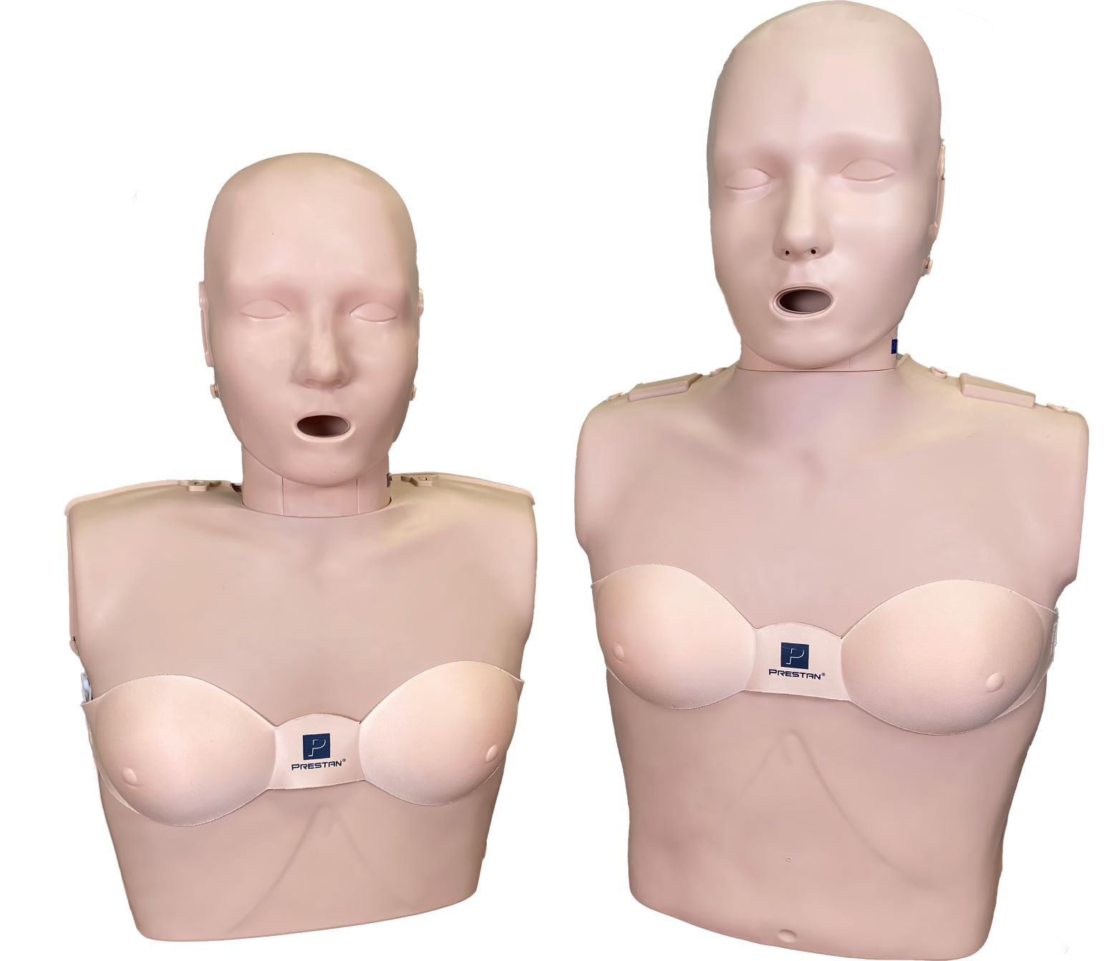
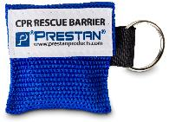
CPR Training Supplies

Slide 9
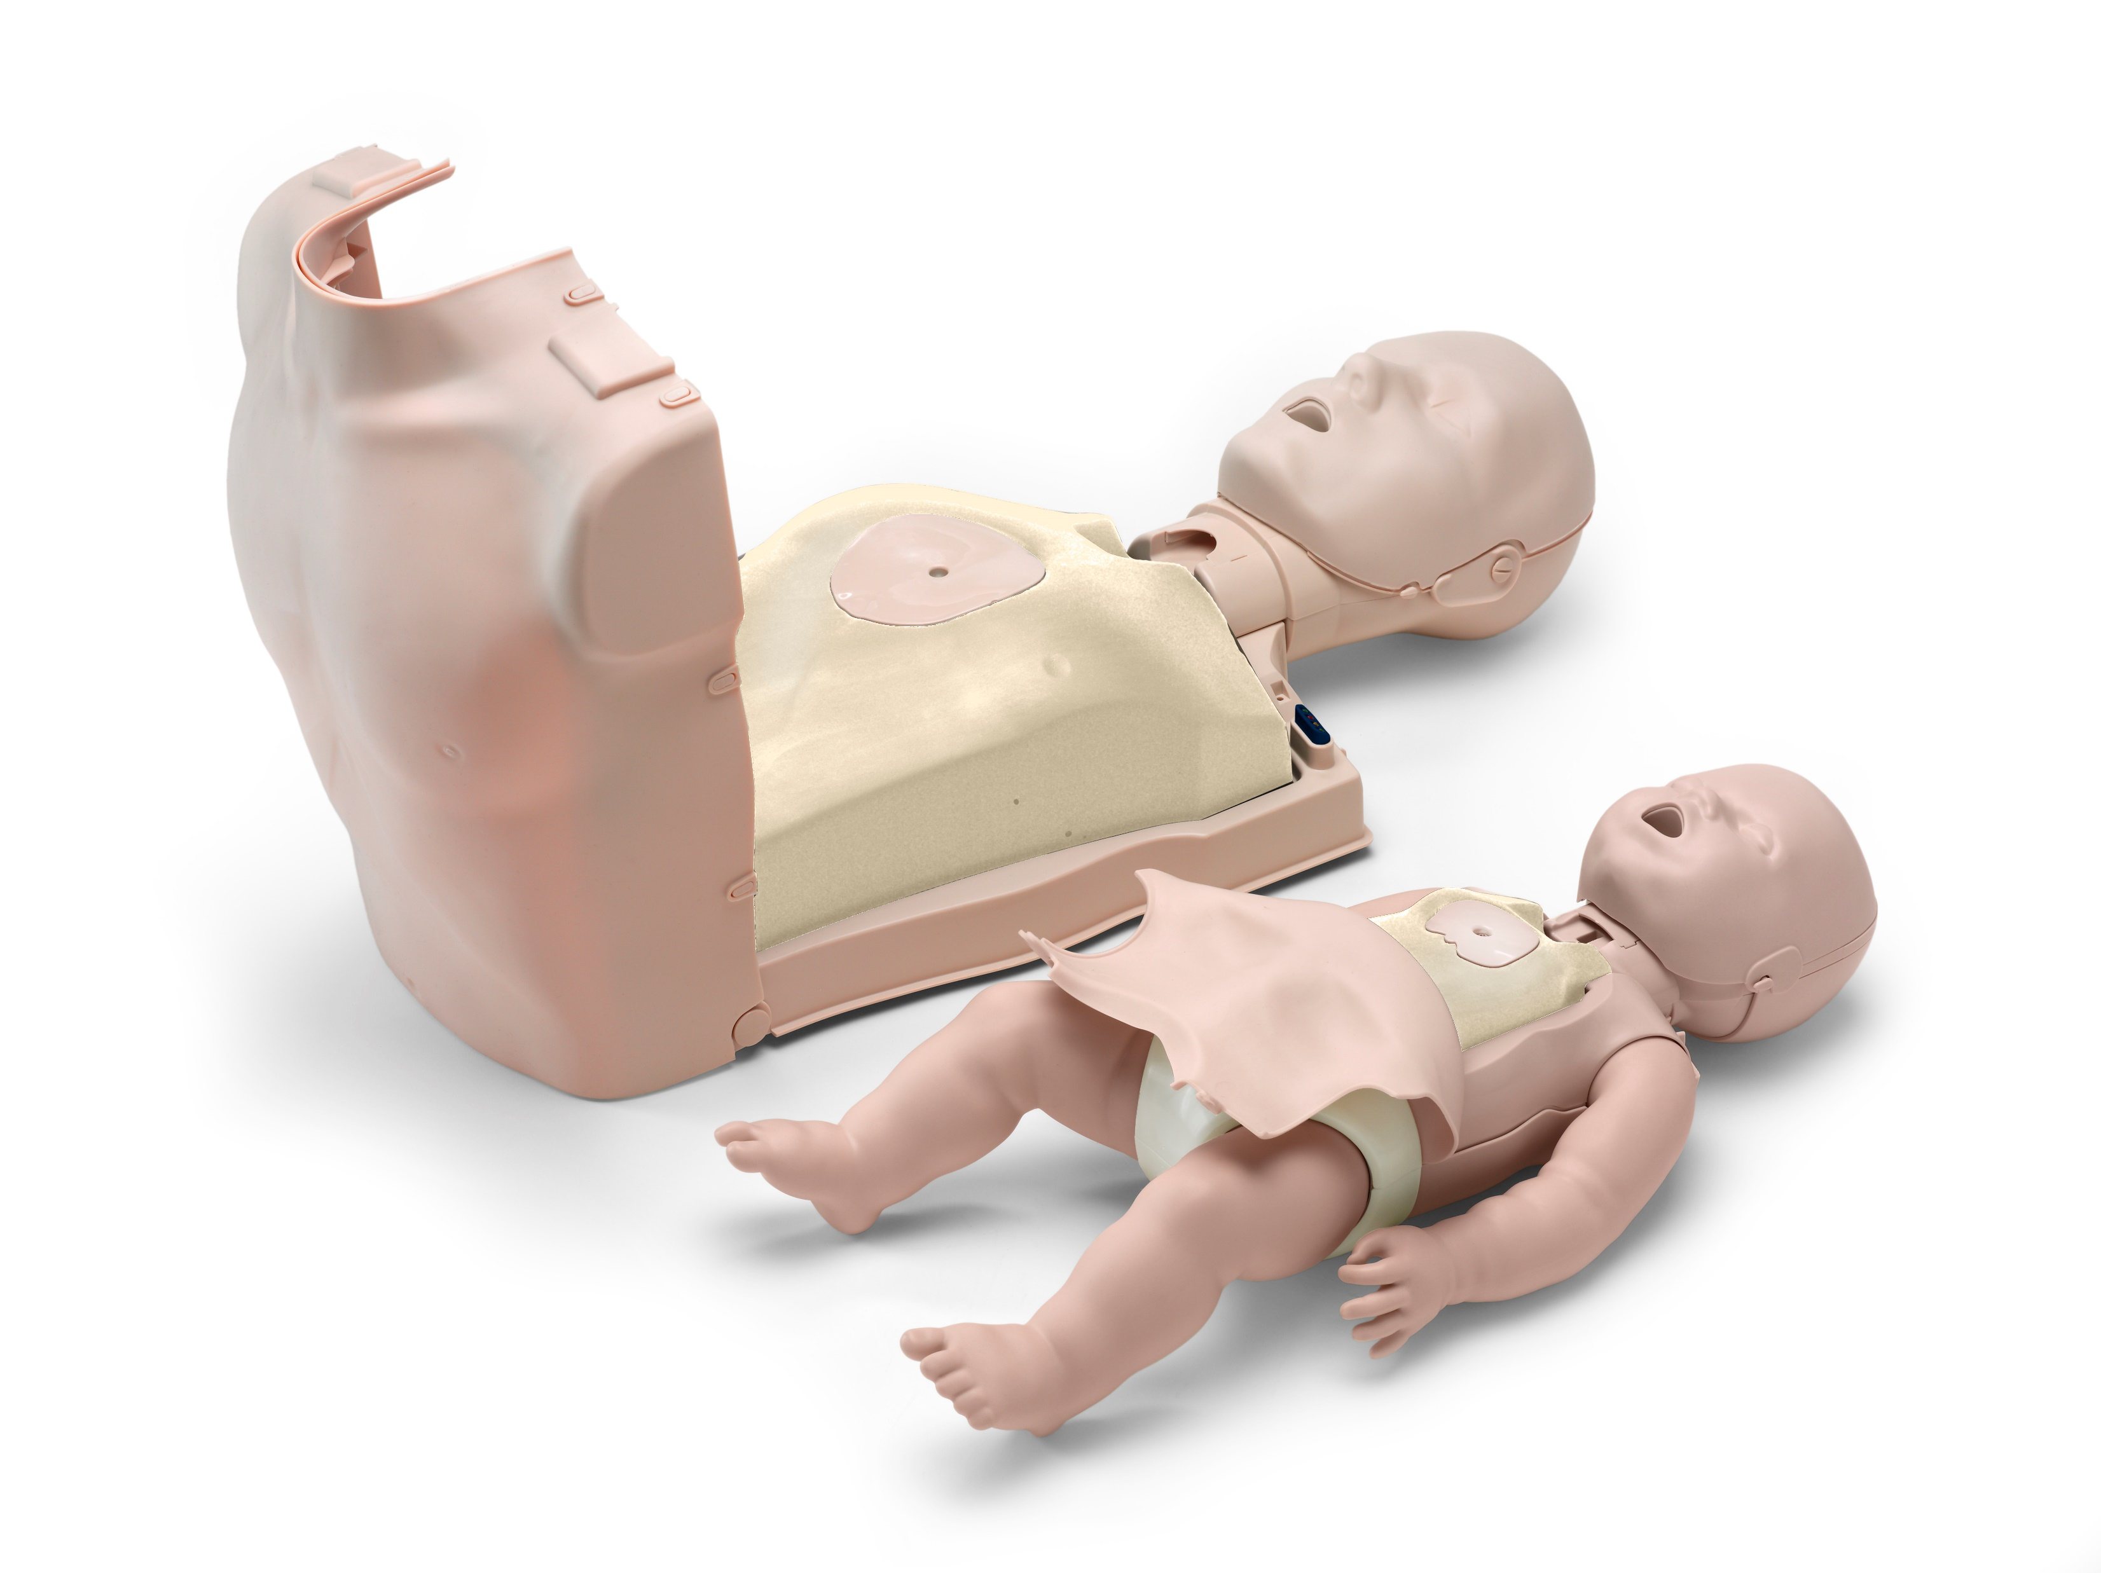
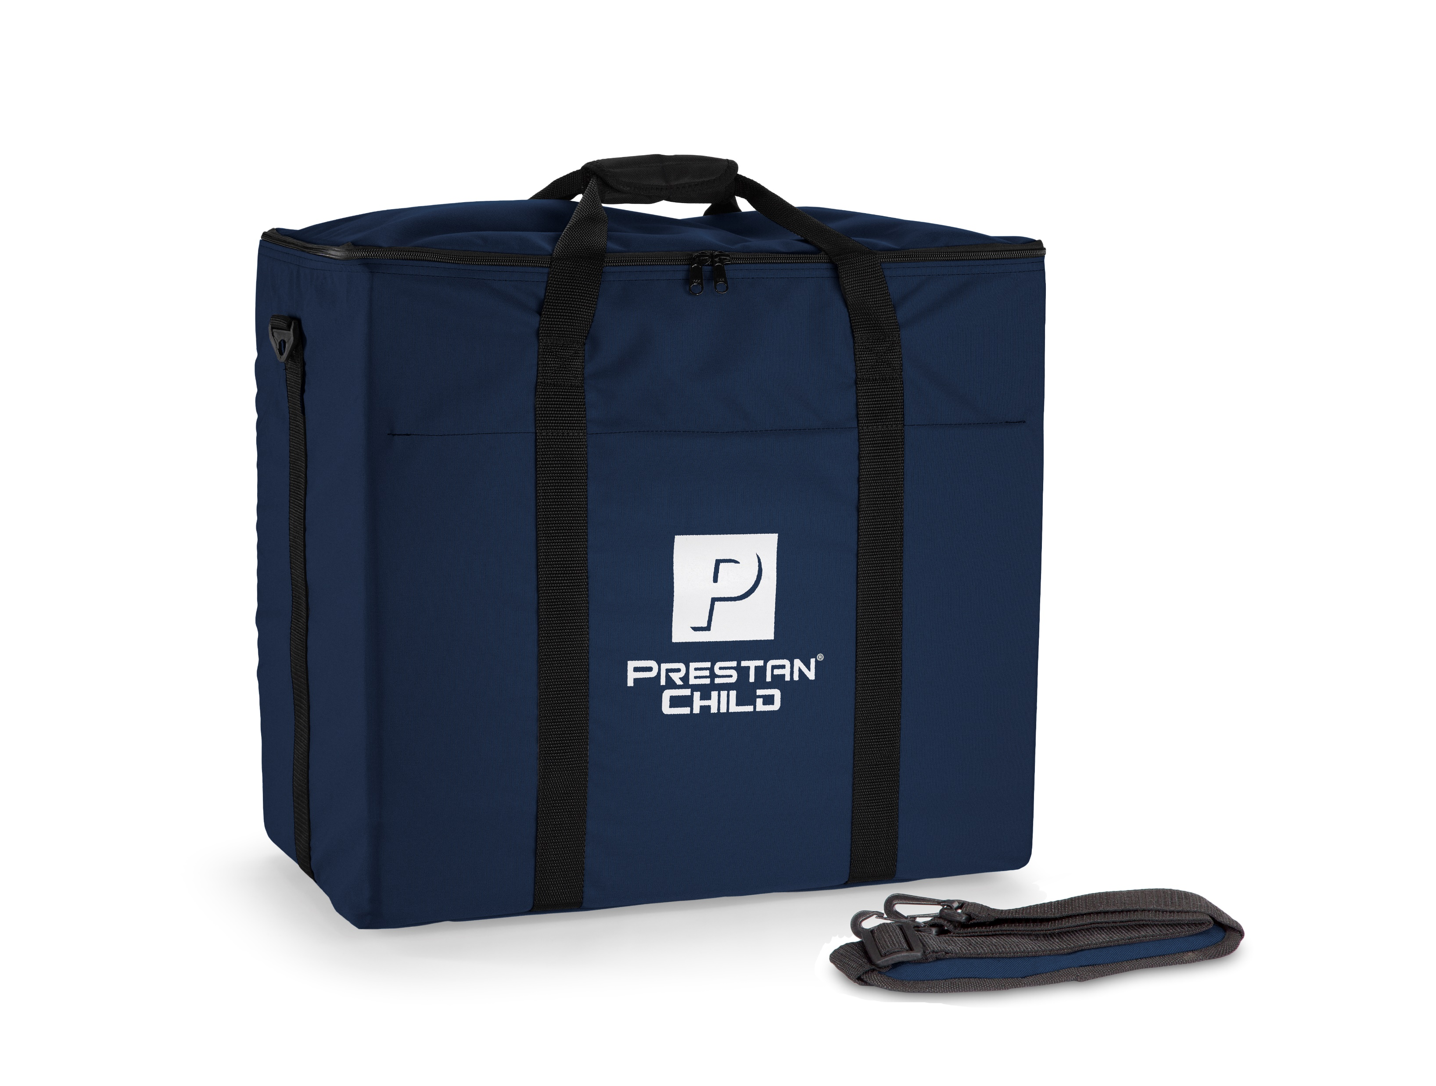
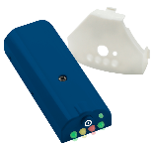
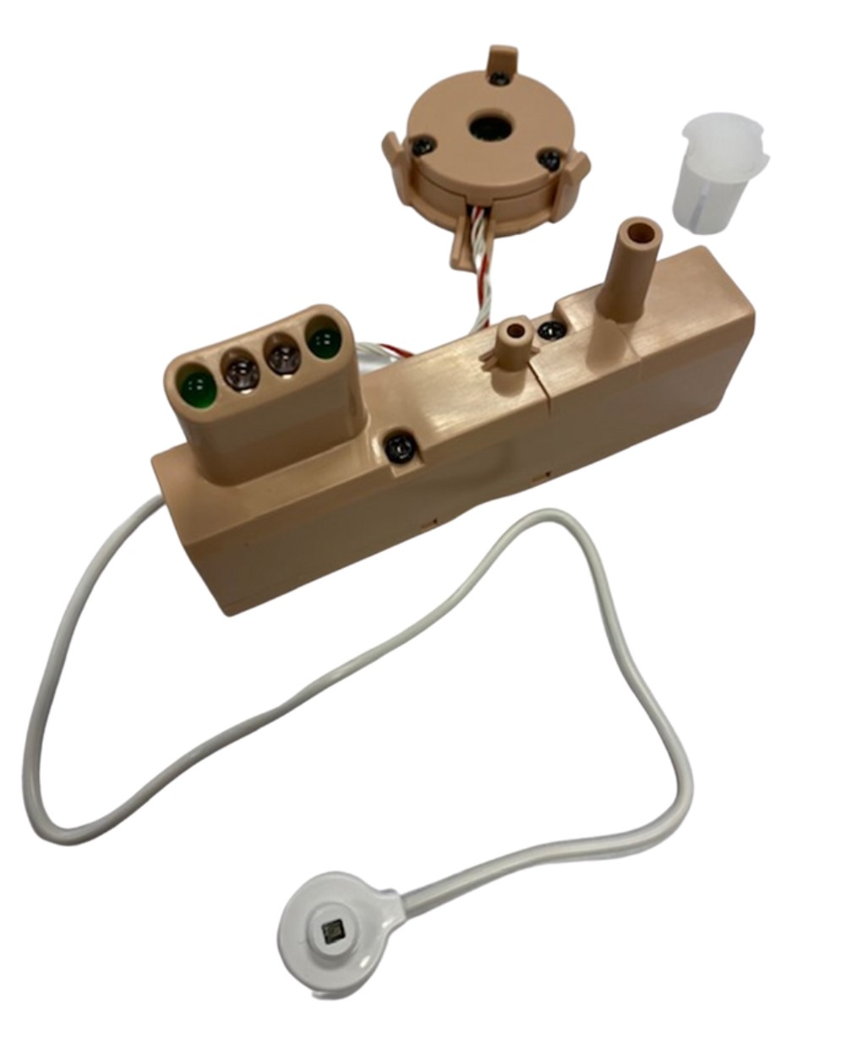
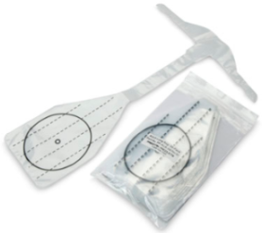
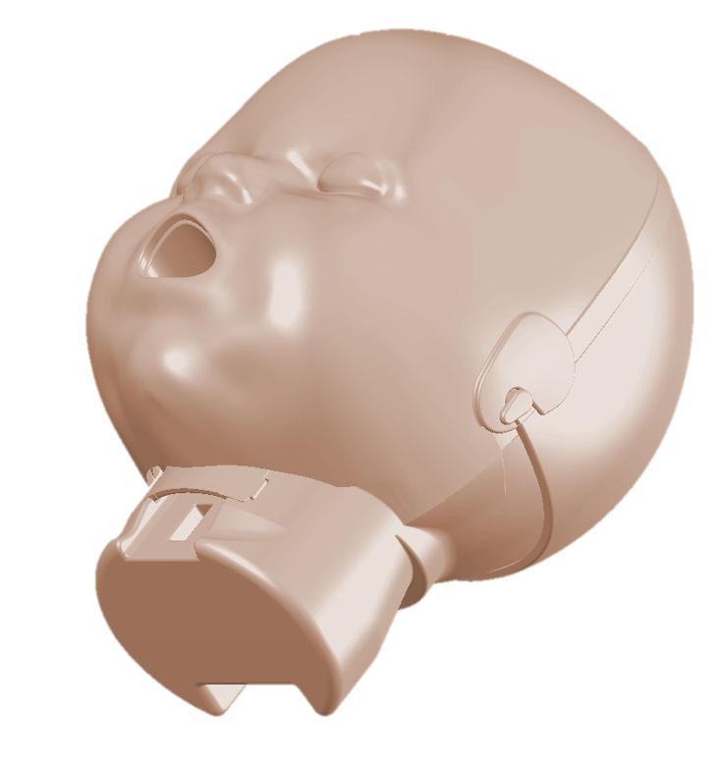
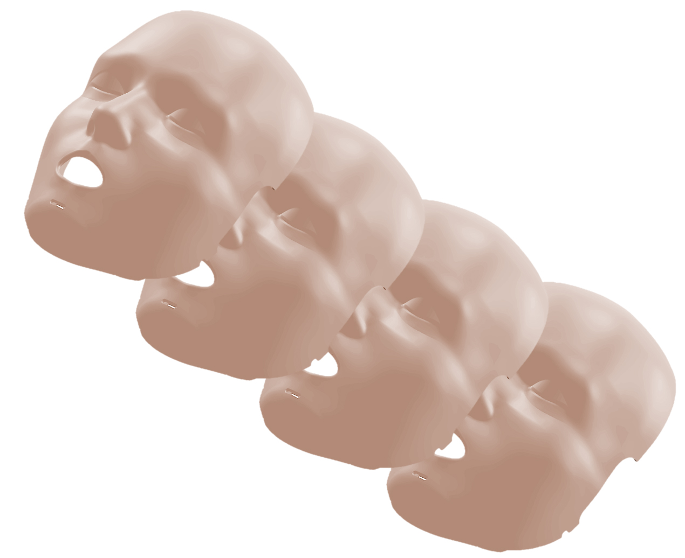
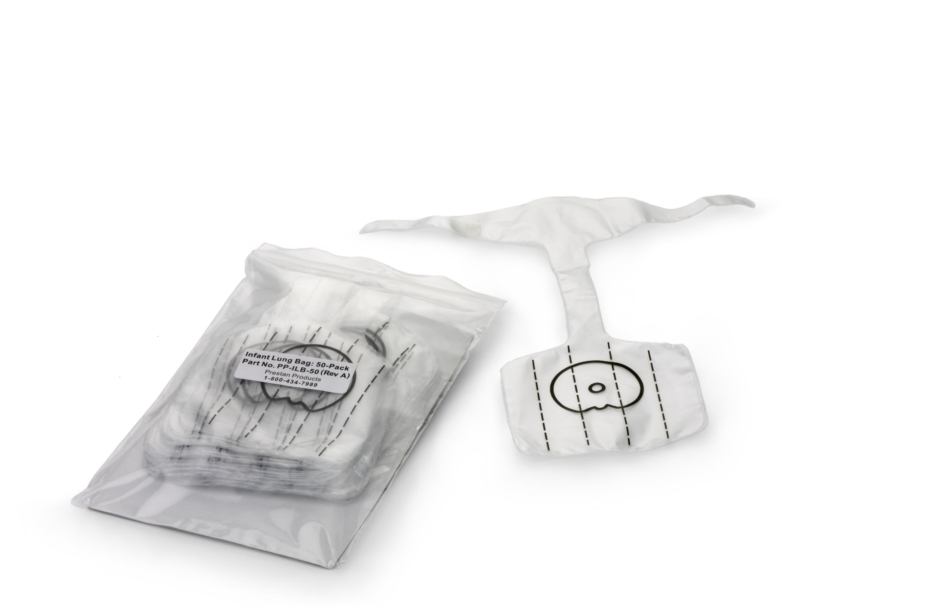
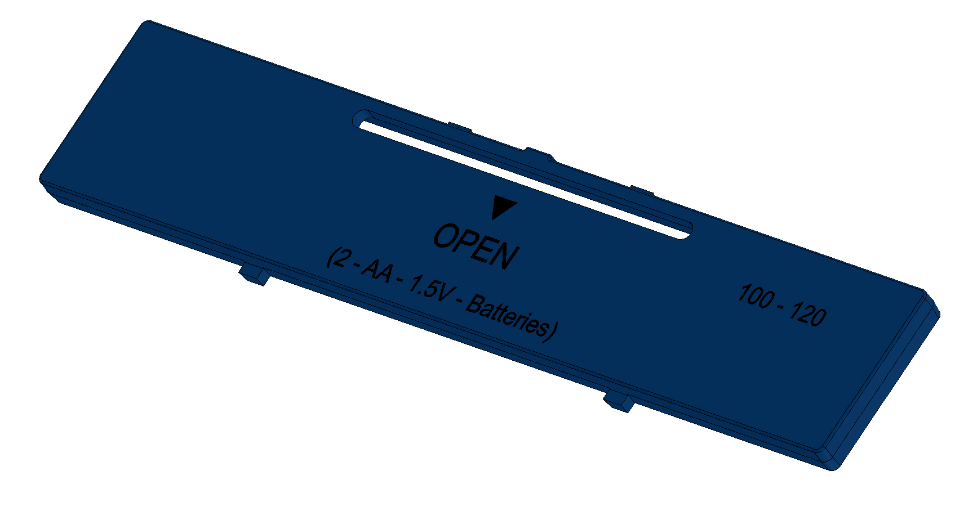
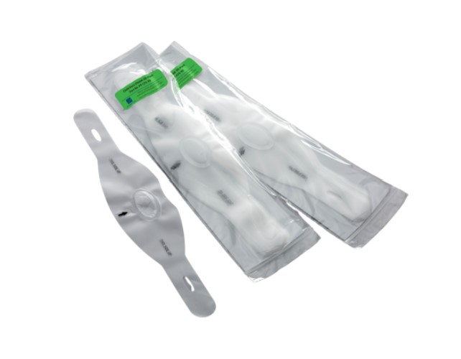
Manikin Parts, Accessories & Consumables

Slide 10
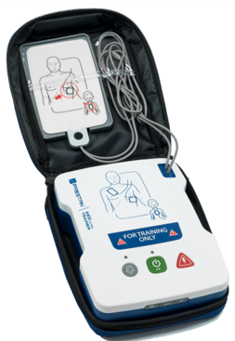
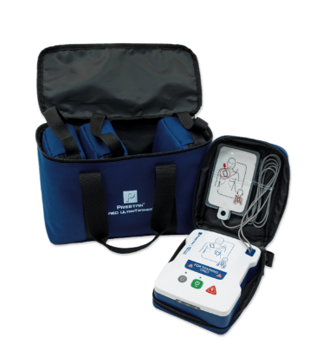
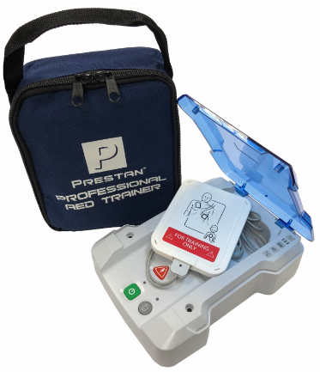
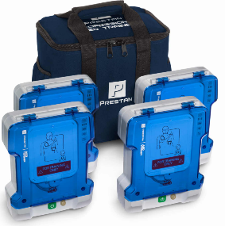
AED Trainer Product Offerings
N
PRESTAN AED UltraTrainerTM
PRESTAN Professional AED Trainer PLUS

Slide 11
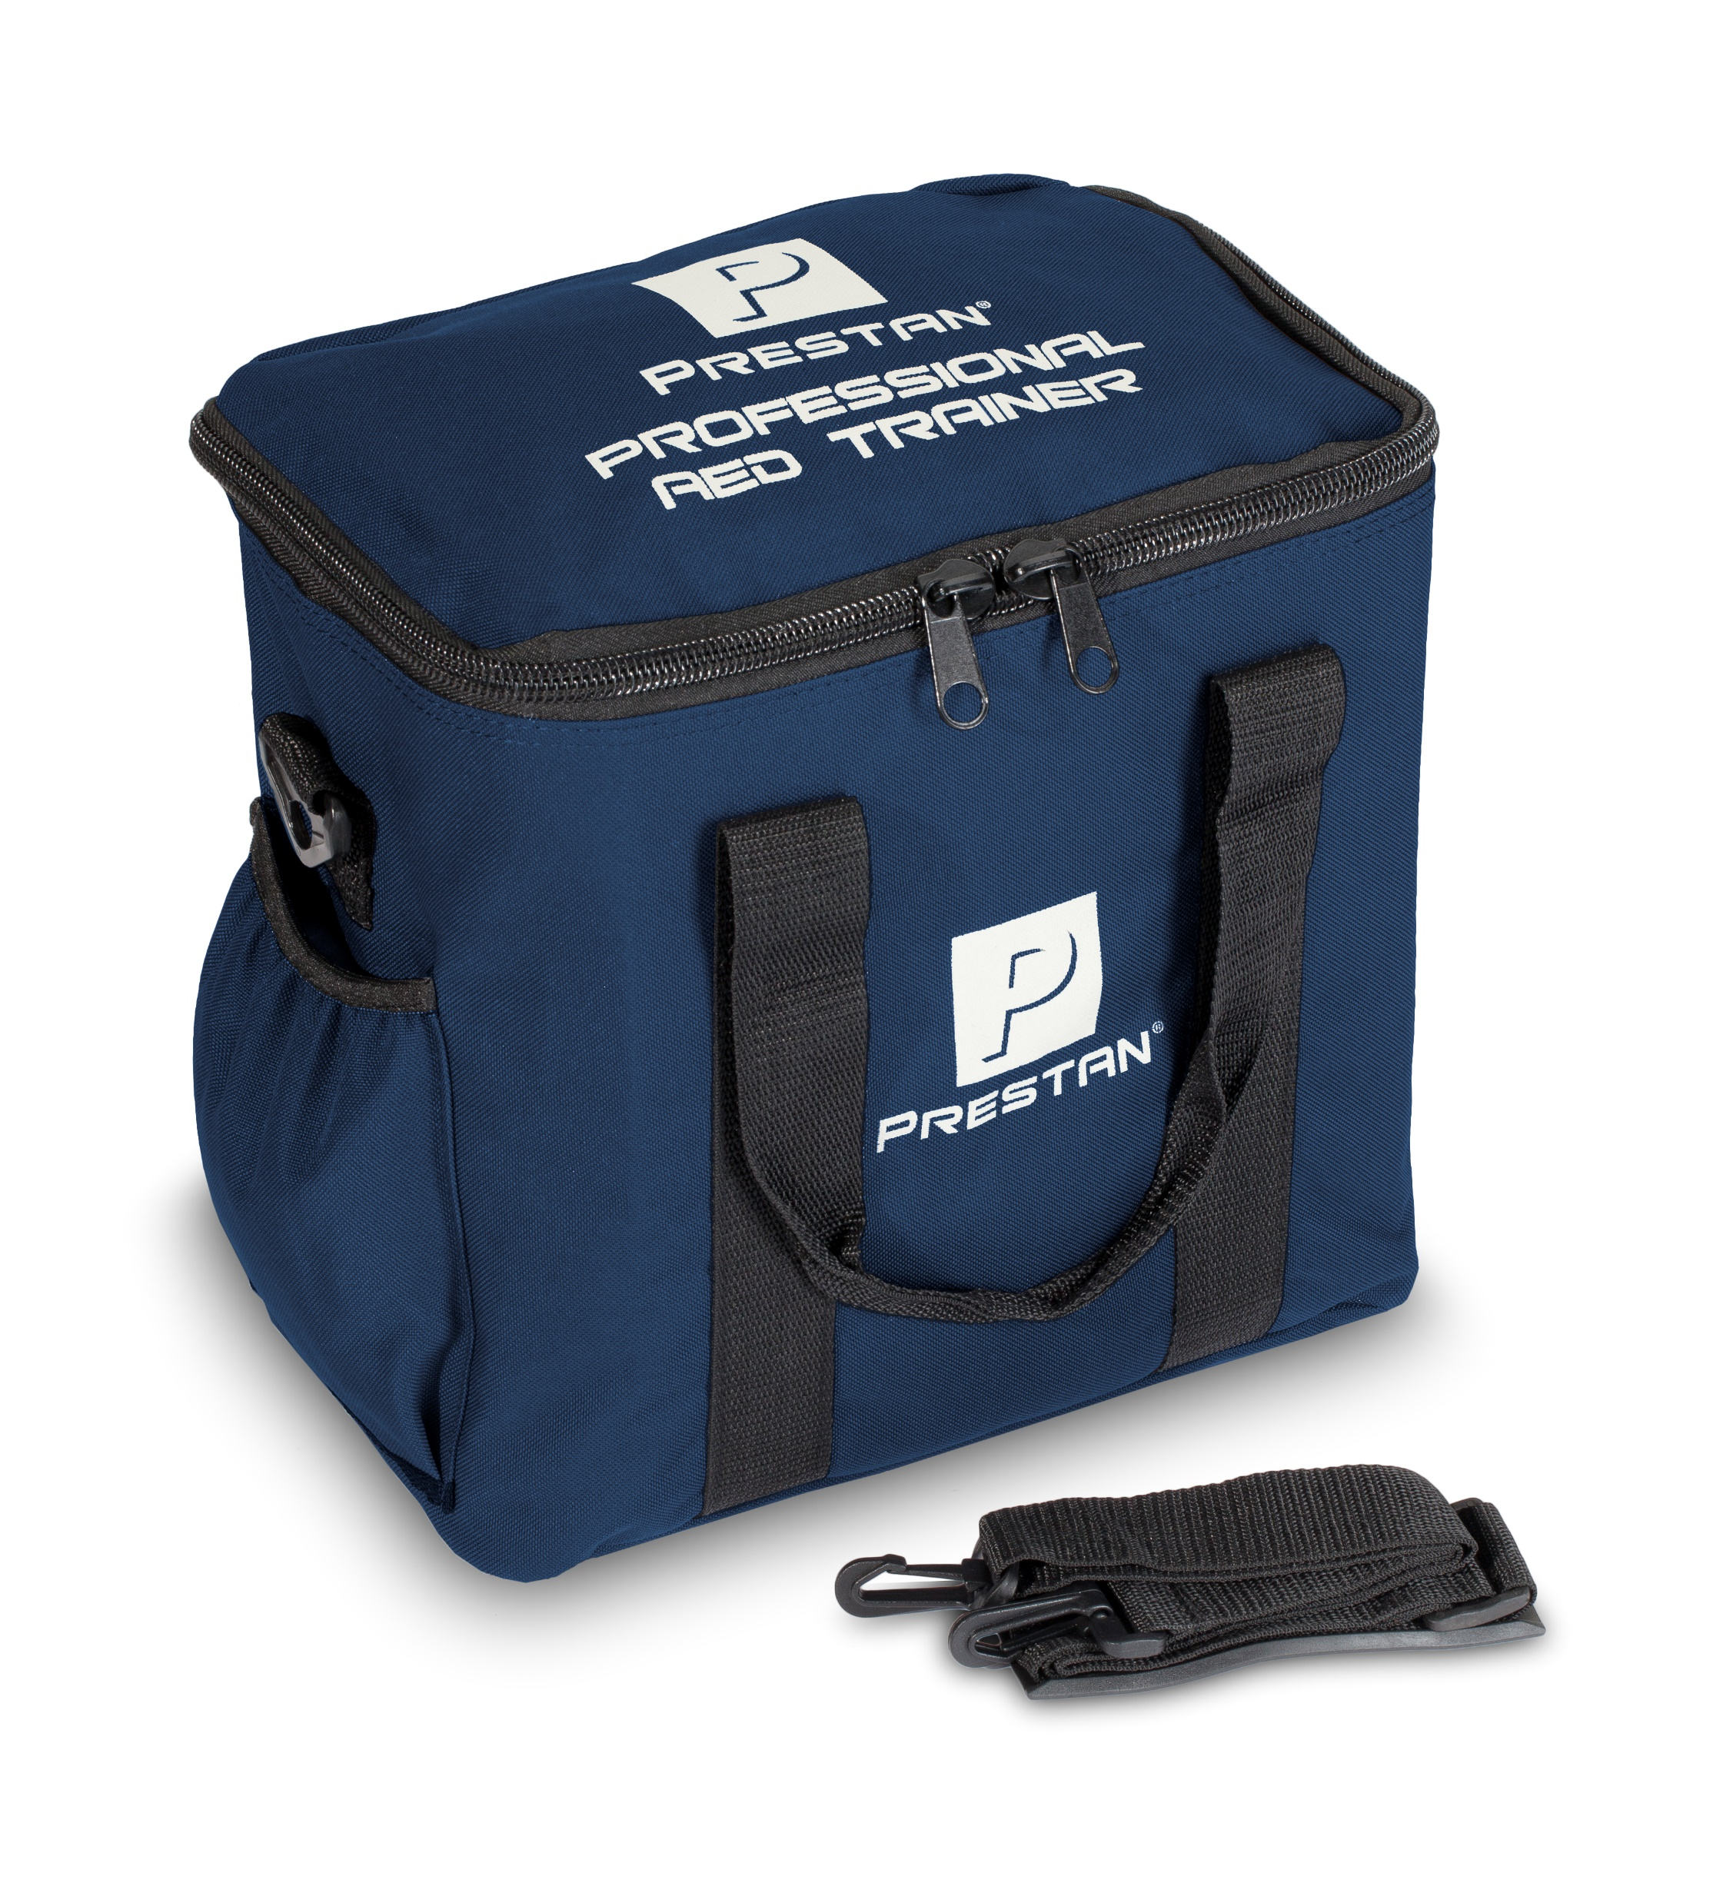
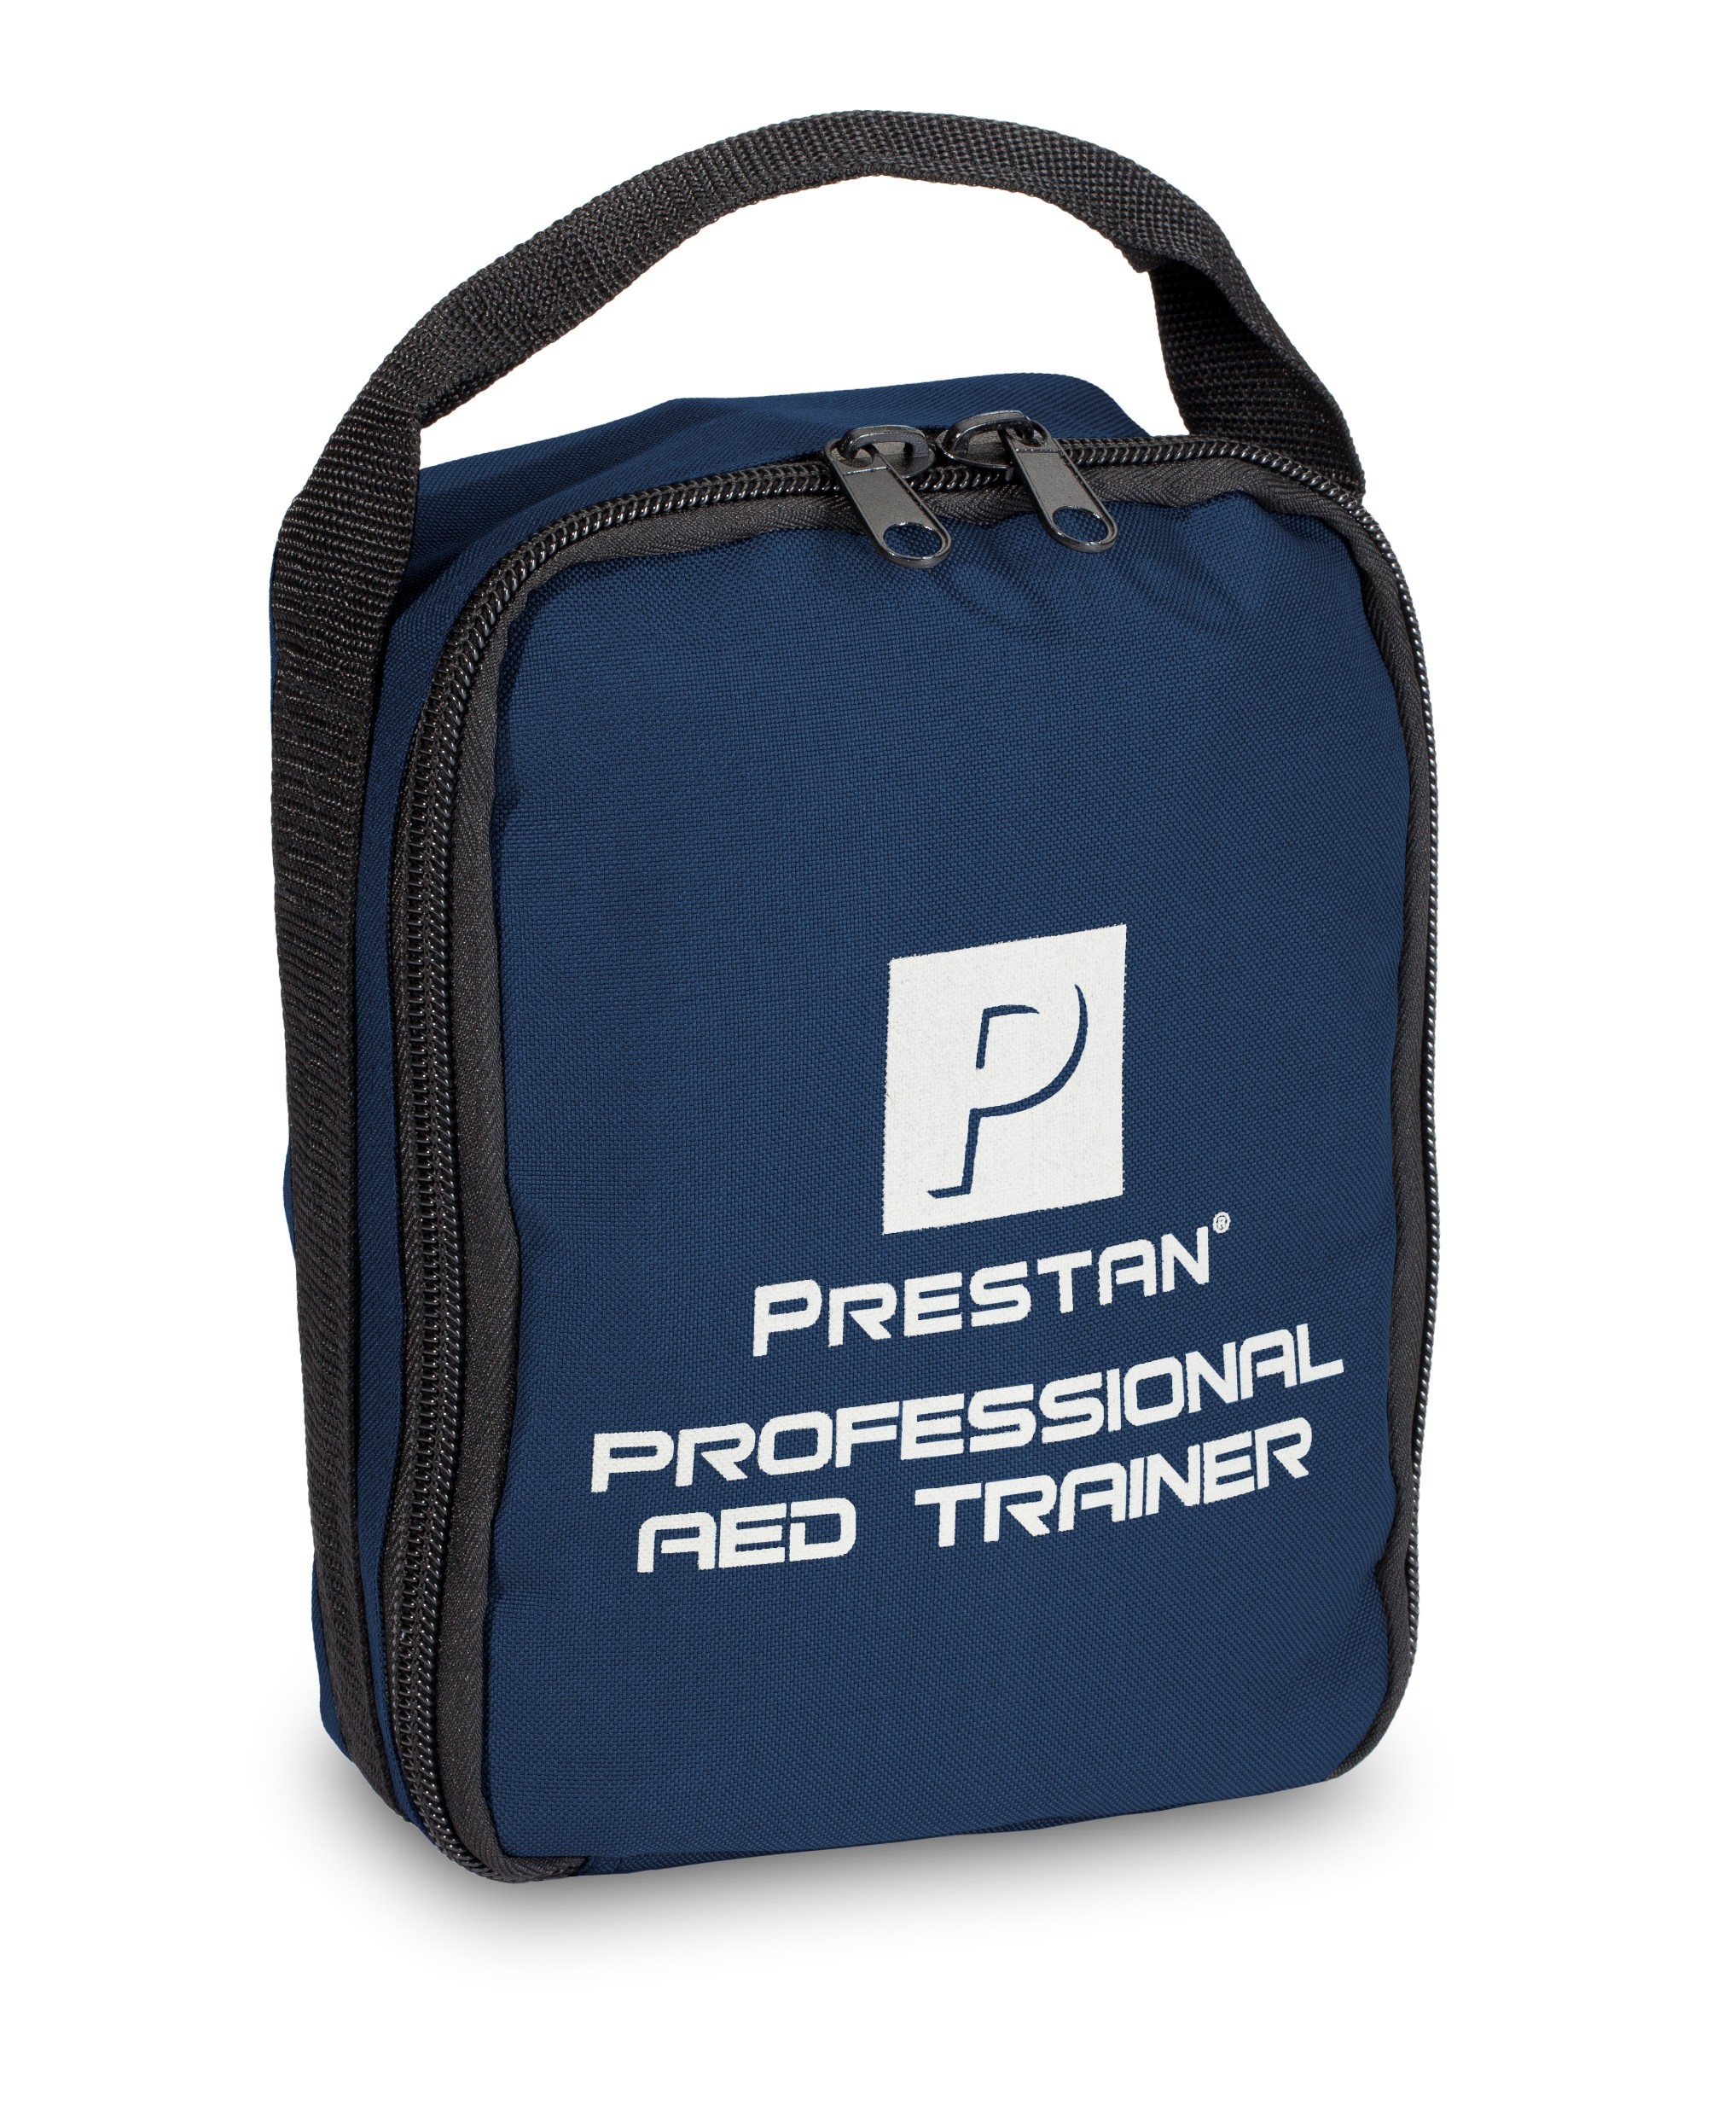
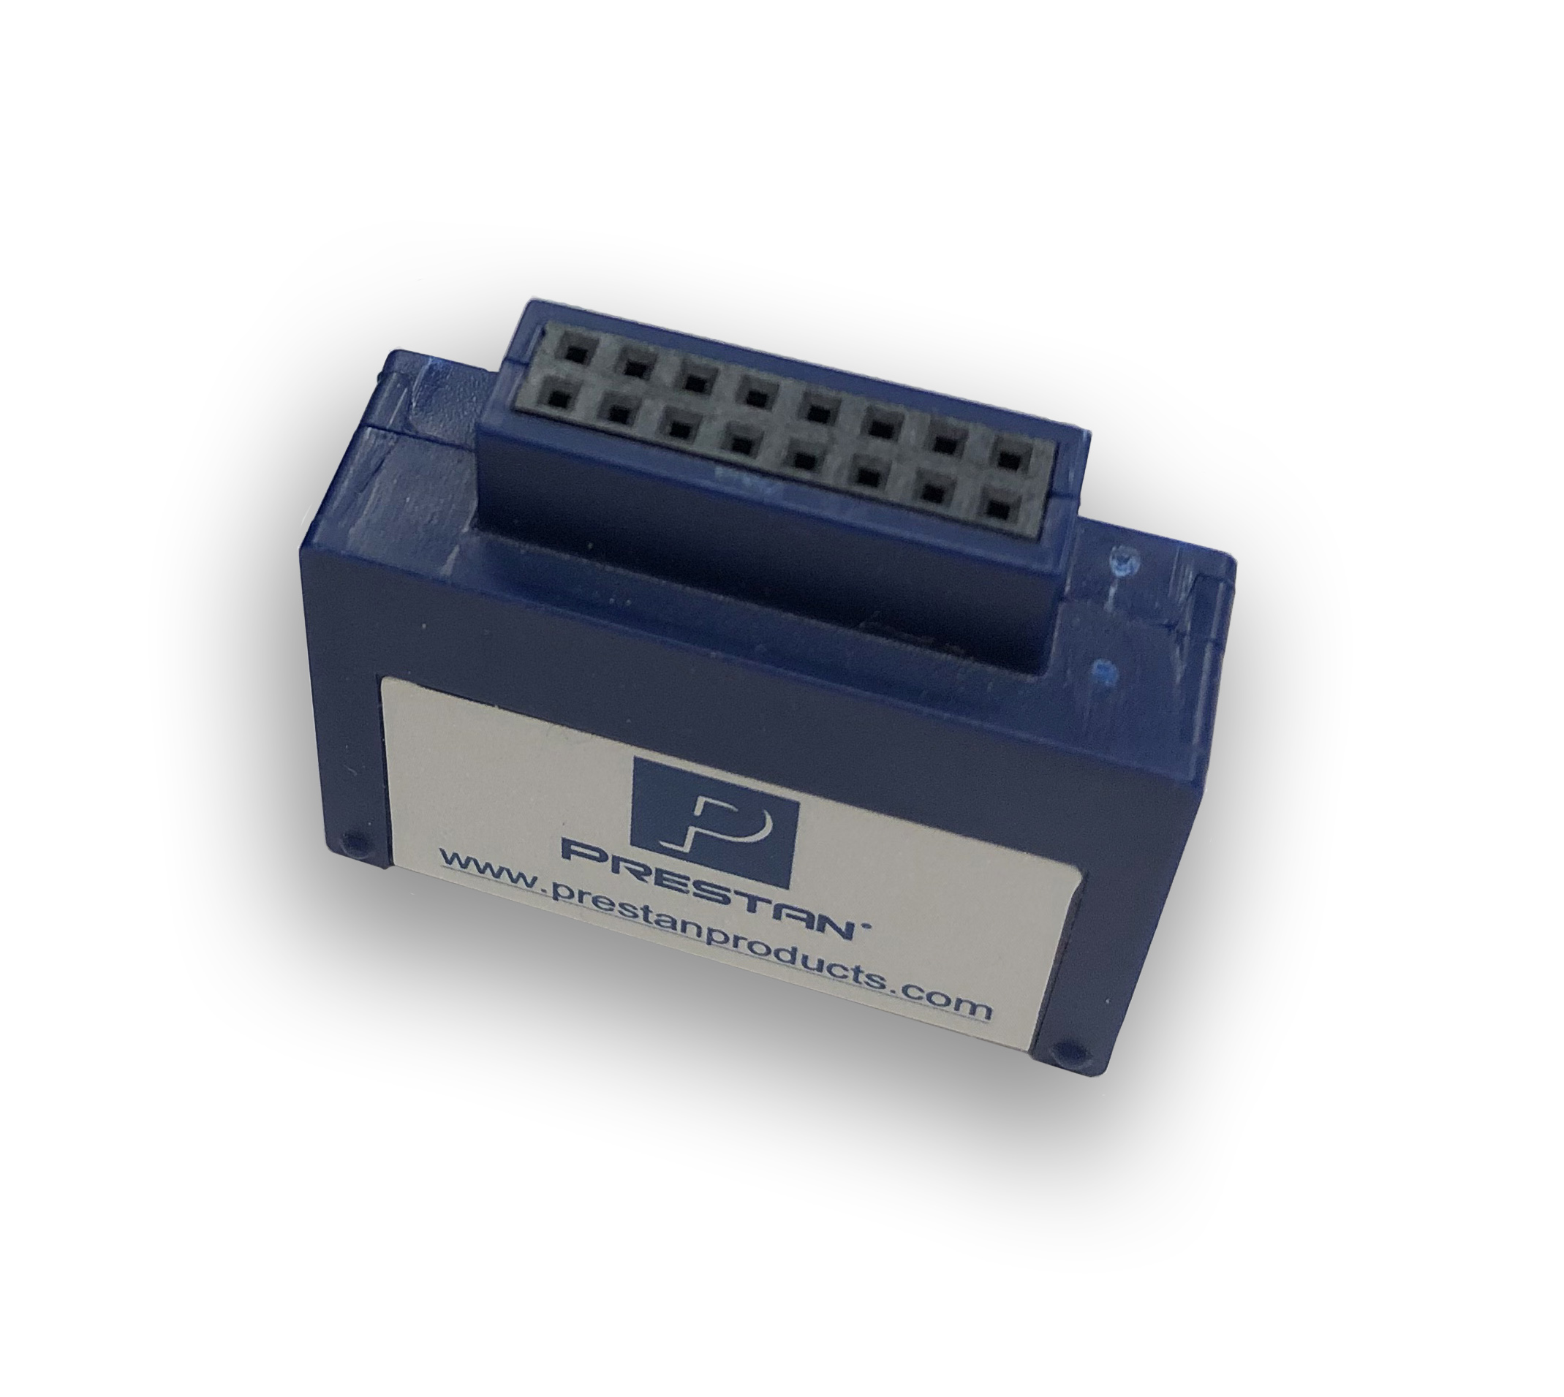
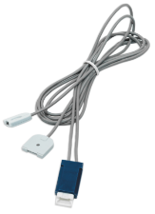
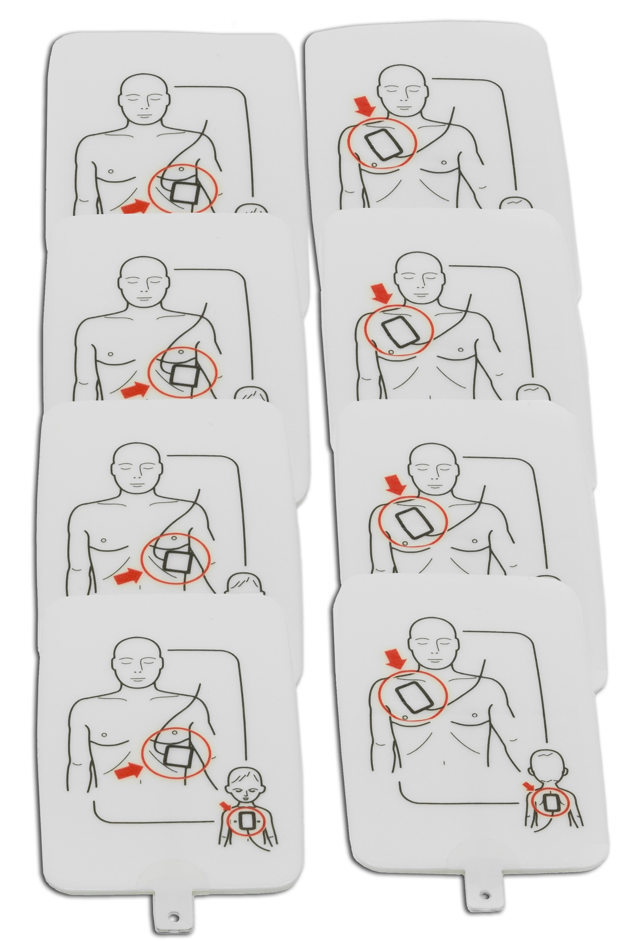
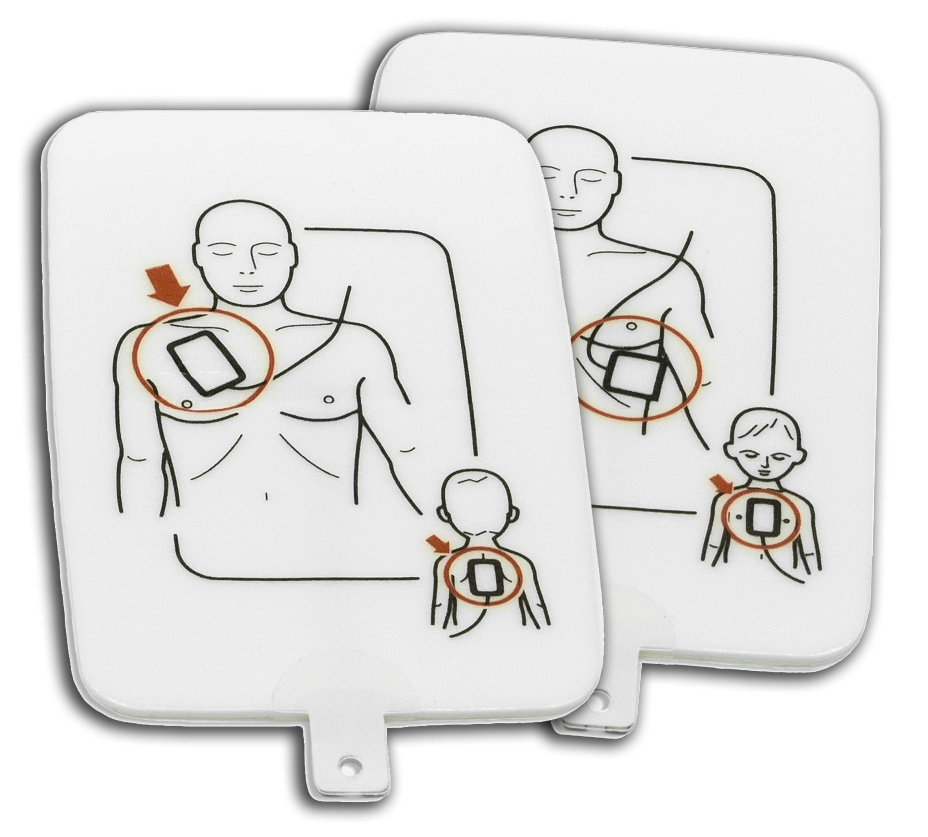
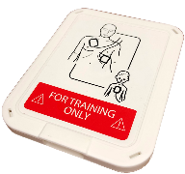
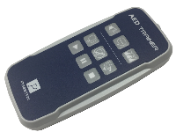
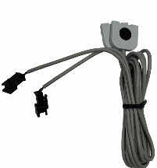
AED Trainer Parts, Accessories & Consumables

Slide 12
Key Product Features

Slide 13
Professional Manikin Key Product Features
Realistic to eye and touch
Lightweight with fast & simple setup
Immediate rate & depth feedback fully compliant with industry guidelines
Recoil, ventilation and hands off time available with Series 2000 Manikin & PRESTAN CPR Feedback App
Easy to clean and maintain
Medium and dark skin tones
Single, 4-pack and specialty packs
3-year warranty
N

Slide 14
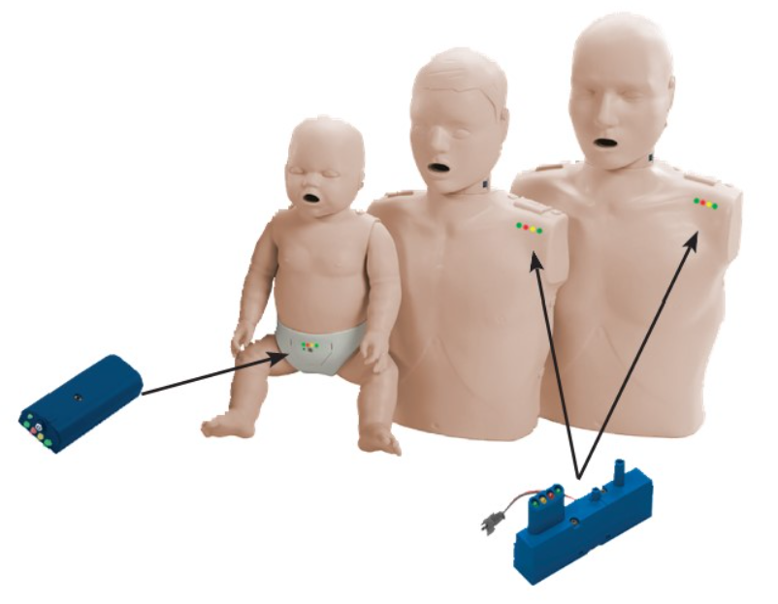
Building Confidence with CPR Feedback
N
Professional Manikin CPR Feedback Video
Professional Series 2000 & CPR Feedback App Video

Slide 15
Face-Shield / Lung-Bag Installation
Specifically designed to fit PRESTAN Adult, Child, and Infant manikins
Easy installation with fast & simple setup
Face-shield secures to mouth with ear pins
Provides visible chest rise with breaths
Ventilation feedback available with Adult Series 2000 Manikin & CPR Feedback App
50-packs available for repeat purchase
N

Slide 16
Cleaning & Storage Recommendations
The face and body of all PRESTAN Manikins can be wiped down with a mixture of soap and water, common household cleaners or disinfecting wipes.
The face skin may be sanitized with alcohol wipes or soaked in a solution of 1/4 cup bleach mixed with one gallon of water for 10 minutes.
Between student uses, an alcohol wipe may be used to clean the face skin as an extra measure of safety.
The PRESTAN Female Accessory should be hand wash in cold water with a mild detergent and hung to dry
DO NOT wash with detergent containing bleach, machine wash or place in the dryer.
All PRESTAN storage bags can be wiped down and surface cleaned only with a mixture of soap and water, common household cleaners or disinfecting wipes.
N

Slide 17
Product Demo

Slide 18
Professional Adult Series 2000 Manikin – Demo/Video

Slide 19
Professional Adult Series 2000 Manikin
Dual-purpose training solution
Traditional rate monitor in shoulder and clicker (beep) provides basic rate and depth
Advanced feedback including rate, depth, recoil, ventilation, and hands-off time provided with PRESTAN CPR Feedback App
Add-on Kit available to upgrade PRESTAN Professional Adult and Jaw Thrust Manikins (2018 model or newer)
Model date can be found on back of manikin torso
1-year warranty

Slide 20
PRESTAN CPR Feedback App
Free PRESTAN CPR Feedback app available on Apple & Android devices
Monitor & report Advanced CPR Feedback via Bluetooth® connection
Allows instructors to monitor up to six students at one time
Or students can monitor on their own personal device for self-correction

Slide 21
PRESTAN CPR Feedback App CCF Calculation
Chest Compression Fraction Calculation
Hands-on Time/Total CPR Cycle Time = Chest Compression Fraction
Example
Total CPR Cycle Time = 326 seconds (5 min, 26 sec)
Hands-off Time = 21 seconds (3 cycles at 7 sec each)
Hands-on Time = 305 seconds (326-21 = 305 sec)
Chest Compression Fraction = 94% (305/326 = 0.94 or 94%)

Slide 22
Professional Adult/Child Manikin – Demo/Video

Slide 23
PRESTAN Female AccessoryTM
PRESTAN is committed to building confidence to help save more women’s lives
The PRESTAN Female Accessory
has been designed to:﻿
*Build Confidence in CPR Training
*Improve CPR Survival Rates in Women
*Encourage Dialogue & Breakdown Barriers
*Eliminate Gender Bias in CPR Administration

Slide 24
Professional Infant Manikin – Demo/Video

Slide 25
Training Resources

Slide 26
Professional Adult Series 2000 Manikin Resources
Adult Series 2000 Manikin Instruction Sheet
Cleaning & Storage (pg 3)
Face-Shield / Lung-Bag Overview & Recommendations (pg 4)
CPR Monitor Guide (pg 5)
CPR Feedback App Guide (pg 6-19)
Face-Shield / Ventilation Lung-Bag Installation Guide (pg 20)
Troubleshooting Guide (pg 21-25)
Warranty (pg 26)
Series 2000 Add-On Kit Installation Guide and Installation Video
Series 2000 & CPR Feedback App Troubleshooting Guide
Series 2000 Product Warranty

Slide 27
PRESTAN CPR Feedback App Resources
Series 2000 & CPR Feedback App Troubleshooting Guide
CPR Feedback App Instructional Training Videos
PRESTAN CPR Feedback App: Training Video (15 min full overview)
Downloading the PRESTAN CPR Feedback App
PRESTAN CPR Feedback App: Overview Guide
PRESTAN CPR Feedback App: Ventilation Calibration
PRESTAN CPR Feedback App: Assigning Manikin Color & Number ID
PRESTAN CPR Feedback App: Renaming Your Manikin
Training with the PRESTAN CPR Feedback App
PRESTAN CPR Feedback App: Data Review

Slide 28
Professional Adult Manikin Resources
Adult Manikin Instruction Sheet
Cleaning & Storage (pg 3)
Face-Shield / Lung-Bag Overview (pg 4)
CPR Monitor Guide (pg 5)
Face-Shield / Lung-Bag Installation (pg 6)
Troubleshooting Guide (pg 7-9)
Warranty (pg 10)
General Manikins, Adult FAQs
Adult CPR Rate Monitor Help Guide
Installing Adult Lung Bag Help Guide
Cleaning Adult Clicker Help Guide
Replacing Adult Clicker Help Guide
Replacing Adult Piston Sleeve & Chest Plate Help Guide
Professional Adult Product Video
CPR Feedback Instructional Video
Installing Face-Shield/Lung-Bag Video
Replacing Chest Assembly Video
Professional Manikin Product Warranty

Slide 29
Professional Child Manikin Resources
Child Manikin Instruction Sheet
Cleaning & Storage (pg 3)
Face-Shield / Lung-Bag Overview (pg 4)
CPR Monitor Guide (pg 5)
Face-Shield / Lung-Bag Installation (pg 6)
Troubleshooting Guide (pg 7-9)
Warranty (pg 10)
General Manikins, Adult/Child FAQs
Adult/Child CPR Rate Monitor Help Guide
Installing Adult/Child Lung Bag Help Guide
Cleaning Adult/Child Clicker Help Guide
Replacing Adult/Child Clicker Help Guide
Replacing Adult/Child Piston Sleeve & Chest Plate Help Guide
CPR Feedback Instructional Video
Installing Face-Shield/Lung-Bag Video
Replacing Chest Assembly Video
Professional Manikin Product Warranty

Slide 30
Professional Infant Manikin Resources
Infant Manikin Instruction Sheet
Cleaning & Storage (pg 3)
Face-Shield / Lung-Bag Overview (pg 4)
CPR Monitor Guide (pg 5)
Face-Shield / Lung-Bag Installation (pg 6)
Troubleshooting Guide (pg 7-9)
Warranty (pg 10)
General Manikins, Infant FAQs
Replacing Infant CPR Monitor & Batteries Help Guide
Repairing Infant CPR Monitor Help Guide
Replacing Infant Clicker Help Guide
Replacing Infant Limbs Help Guide
Replacing Infant Chest Foam Help Guide
Professional Infant Product Video
CPR Feedback Instructional Video
Professional Manikin Product Warranty

Slide 31
Q&A

Slide 32
To learn more about how PRESTAN is building confidence, please visit www.prestanproducts.com
[NAME, TITLE]
[E-mail: ]
[Phone: ]

