Slide 1
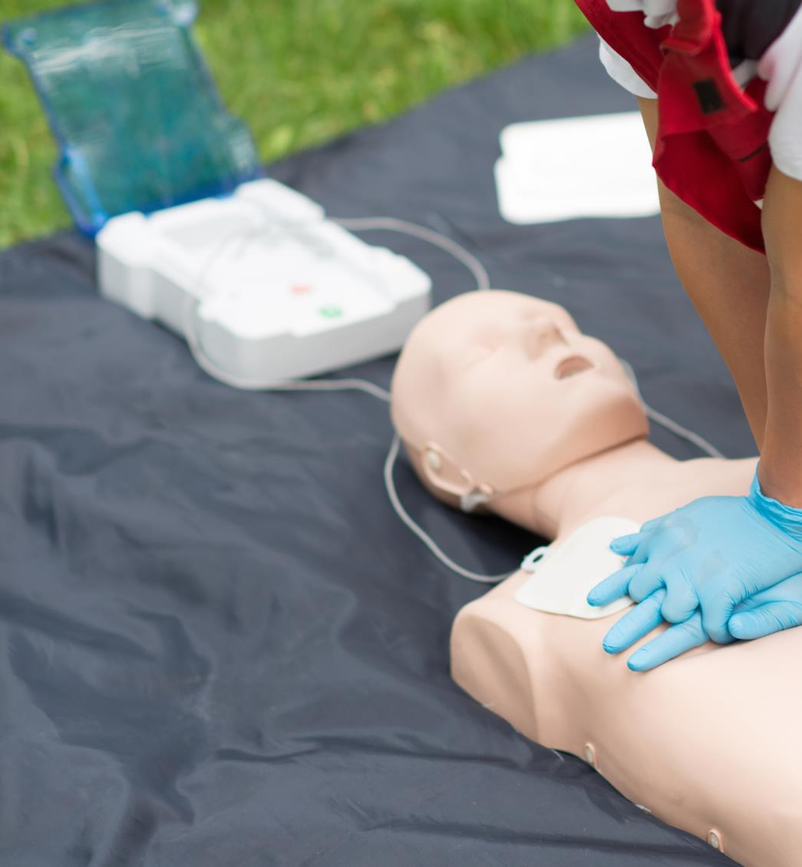
Building Confidence
DATE
NAME - TITLE

Slide 2
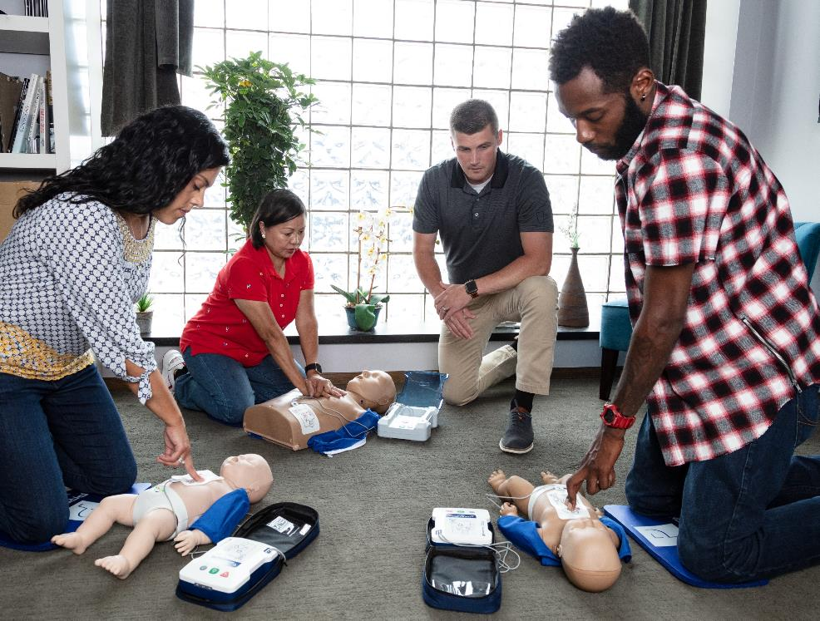
Agenda
PRESTAN Overview
Product Offering
Recent Introductions
Additional Resources

Slide 3
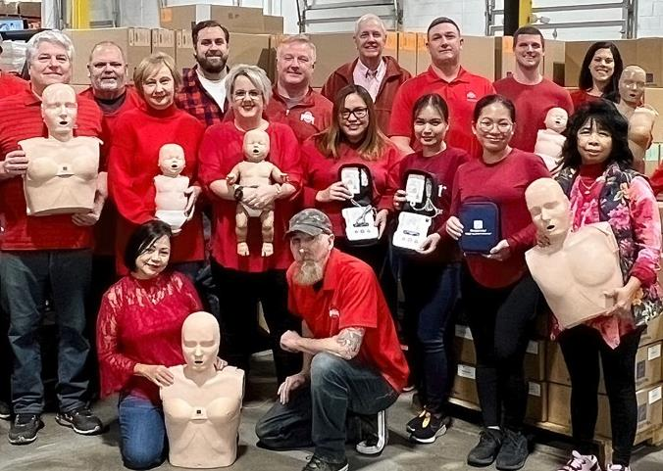
PRESTAN Products Overview
Founded in 2004
Located in Northeastern Ohio
Customers in 70+ countries
Warehousing facilities in the United States, Germany, U.A.E and Malaysia
Design and manufacture PRESTAN CPR Manikins & AED Trainers
All PRESTAN products are sold through Authorized Distributors

Slide 4
Made / Assembled In The USA

Slide 5
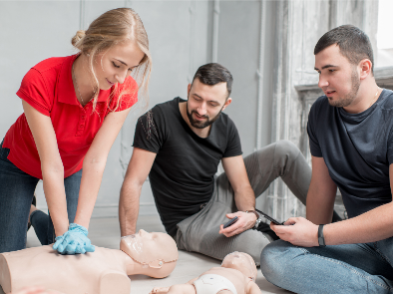
PRESTAN is Committed to Building Confidence…
with Students
provide simple, immediate feedback
realistic CPR training manikin and AED trainer designs
with Instructors
durable, affordable products
easy to setup & clean; compact & lightweight to transport
with Distributors
extension of PRESTAN Sales, Marketing & Customer Service teams
support and enable industry growth through strategic partnership
long term investment in new product development

Slide 6
Product Offering

Slide 7
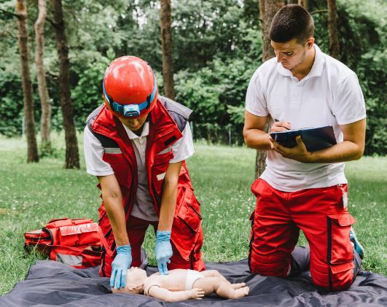
Training Environments & Instructor Needs Vary…
Privileged and Confidential
Privileged and Confidential
Notes:
Training environments can vary from large training centers, hospital-based classrooms, schools & businesses, on-site or even virtual learning. Being able to adapt to each of these settings with equipment is important.

Slide 8
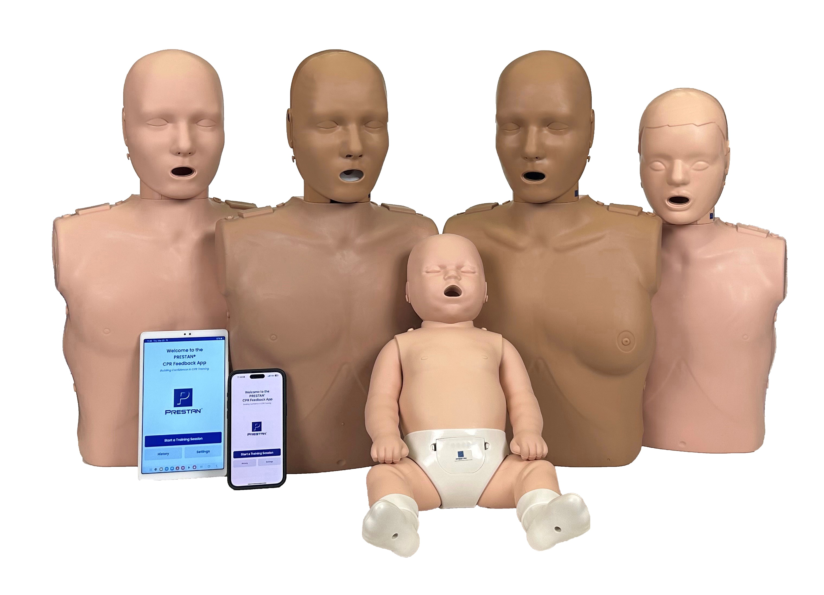
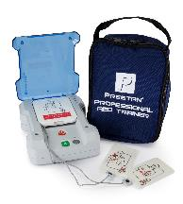
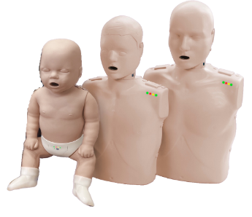
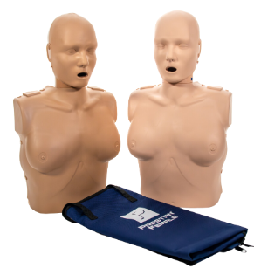
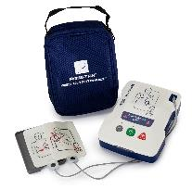
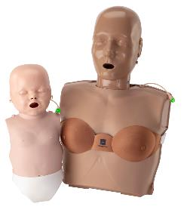
PRESTAN Product Positioning
Advanced
Professional
Features & Benefits
Portable
Basic CPR Training
Advanced CPR Training

Slide 9
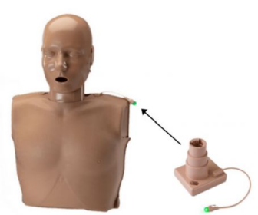
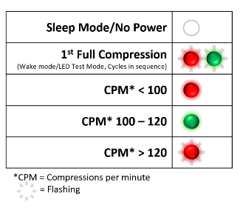
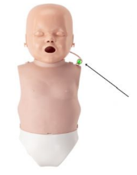
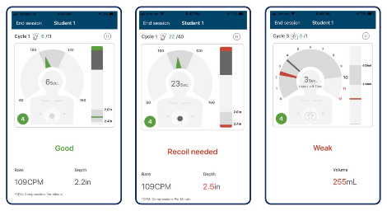
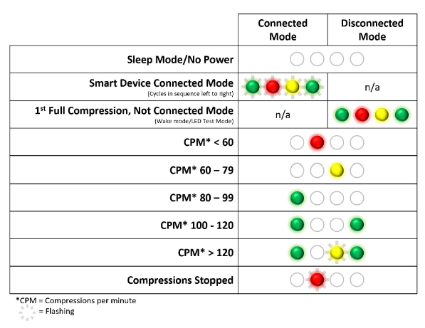
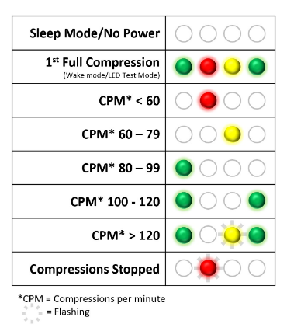
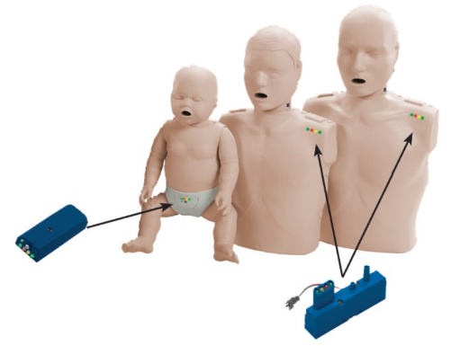
Building Confidence with Feedback…
N

Slide 10
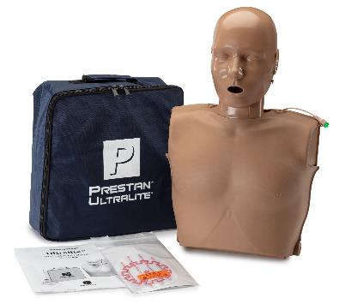
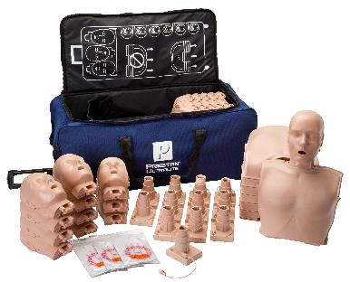
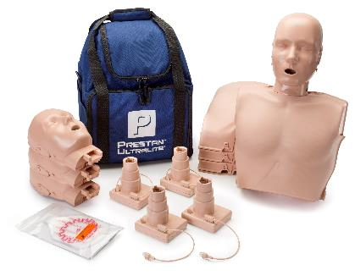
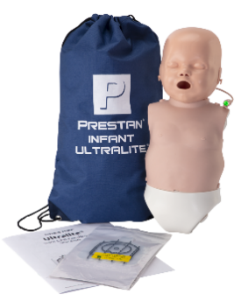
Portable – Ultralite® Manikins
Lightweight, stackable torsos and heads create compact package for easy transport
Adult: Single (3.25 lbs); 4-pack (13 lbs); 12-pack (39 lbs)
Infant: Single (1.6 lbs); 4-pack (5.8 lbs); 12-pack (15.5 lbs)
Simple to set up, easy to use & clean
Affordable solution for new instructors
Medium and dark skin tones
Single, 4-pack, 12-pack and Diversity & TAKE2 Kits
3-year warranty
N

Slide 11
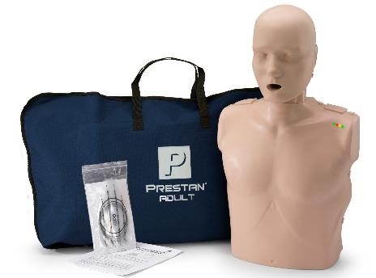
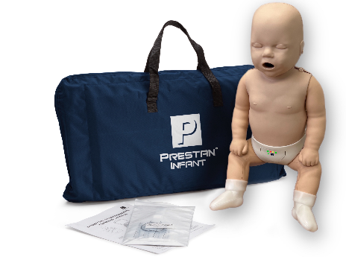
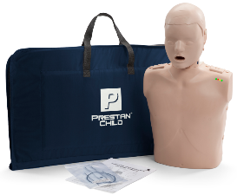
Professional – Professional Manikins
Anatomically correct design; realistic to eye and touch
Robust, durable, reliable construction
Fast & simple setup; easy to use and clean
Original PRESTAN manikin design
Immediate rate & depth feedback - fully compliant with industry guidelines
Medium and dark skin tones
Single, 4-pack, Diversity, TAKE2 & Specialty Kits
3-year warranty
N

Slide 12
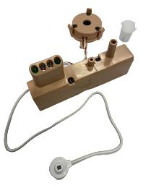
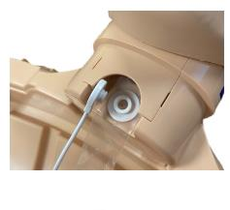
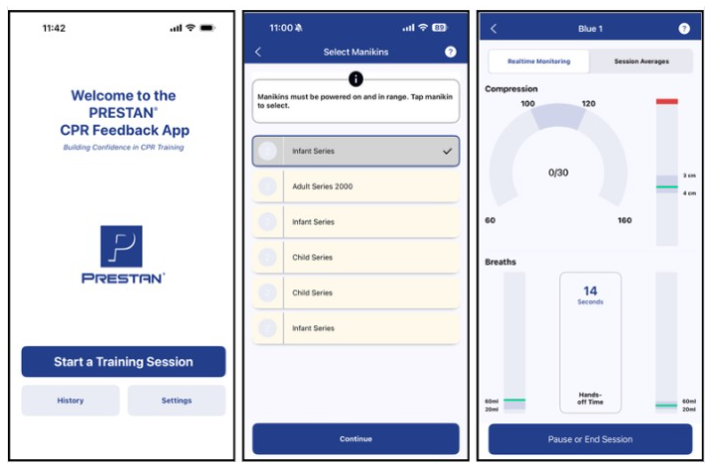
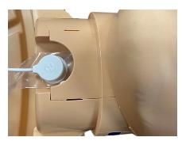
Advanced – Professional Series 2000
Dual-purpose training solution
Traditional rate monitor in shoulder and clicker (beep) provides basic rate and depth
Advanced feedback including rate, depth, recoil, ventilation, and hands-off time provided with PRESTAN CPR Feedback App
Add-on Kit available to upgrade PRESTAN Professional Adult and Jaw Thrust Manikins (2018 model or newer)
Model date can be found on back of manikin torso
Medium and dark skin tones
Single and 4-pack configurations
3-year warranty

Slide 13
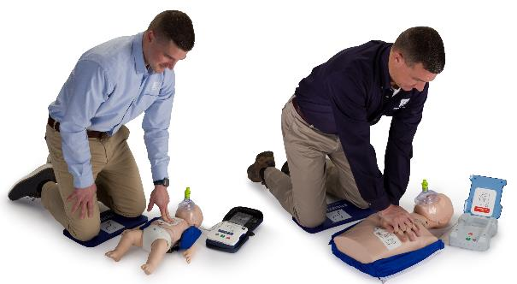
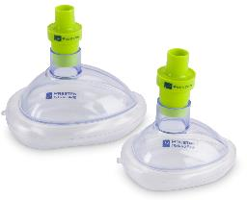
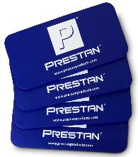
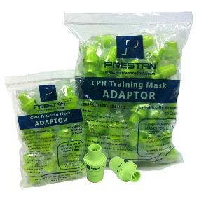
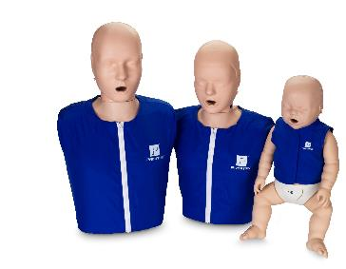
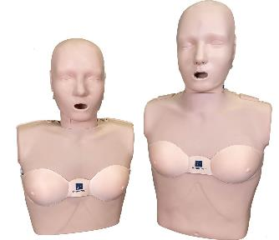
PRESTAN CPR Training Supplies

Slide 14
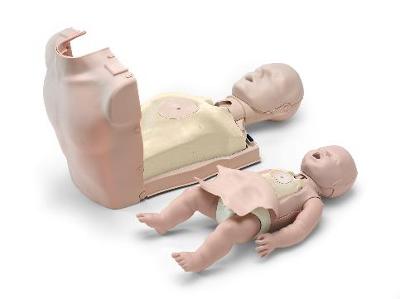
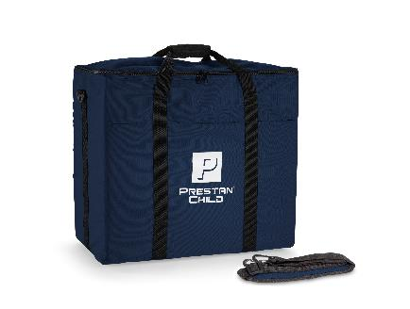
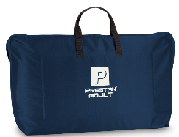
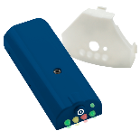
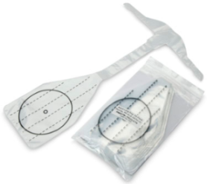
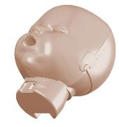
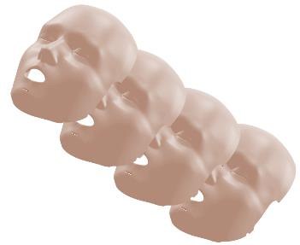
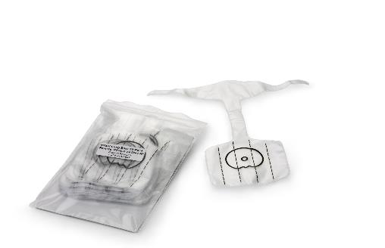
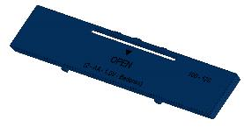
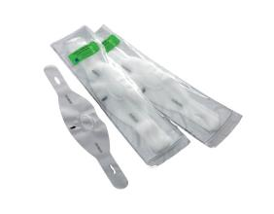
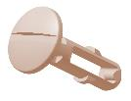
Manikin Parts, Accessories, and Consumables

Slide 15
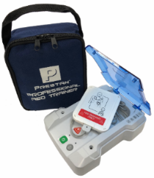
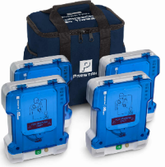
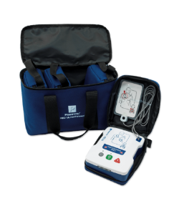
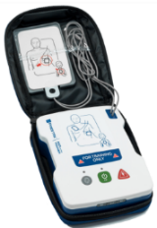
AED Trainer Product Positioning
Professional
Portable
Features & Benefits
PRESTAN Professional AED Trainer PLUS
PRESTAN AED UltraTrainerTM

Slide 16
Portable – AED UltraTrainerTM
Resembles live training experience with pediatric option
Fully customizable to accommodate any classroom training situation
Compact and lightweight
High quality, durability and affordability
Dual language with multiple language options available
Single and 4-pack
3-year warranty
N

Slide 17
Professional – Professional AED Trainer PLUS
High quality, leading-edge AED Trainer that most closely resembles brand AED Trainers in size and weight for realistic training experience
Fully customizable to accommodate any classroom training situation
Dual language with multiple language options available
Optional remote with control of several AED Trainers
Single and 4-pack
3-year warranty
N

Slide 18
Patented AED Trainer Pads Product Features
Automatically detects when AED Trainer Pads are placed on CPR Training Manikin
Programming runs through sensor in center of the Trainer Pad adhesive which most realistically simulates a live AED
No remote control is necessary, although one is available for the Professional AED Trainer PLUS, if desired
AED Trainer Pads last for over 100 applications; pad adhesive adheres and removes well to any manikin on the market without leaving messy residue
Pad replacement is affordable and simple – just replace the pad, not the cord
N

Slide 19
AED Trainer Parts, Accessories, and Consumables

Slide 20
Recent Introductions

Slide 21
PRESTAN Series 2000 Complete Offering
PRESTAN is committed to building confidence with a dual-purpose training solution that offers both basic and advanced CPR feedback.

Slide 22
PRESTAN (Series 2000) CPR Feedback App
The new PRESTAN CPR Feedback App provides:
an improved user experience
expanded list of available languages
more intuitive CPR feedback - with the addition of chest compression fraction
PRESTAN owned technology - allows for ongoing improvements and faster updates

Slide 23
PRESTAN Instructor Kit
The PRESTAN Instructor Kit combines our most popular CPR Training Manikins and AED Trainer along with a collection of CPR Training Supplies making this an ideal starter kit and easy to transport all-in-one training solution.
Notes:
The PRESTAN Infant Ultralite Manikin is now available.

Slide 24
PRESTAN Professional Female Manikin
The PRESTAN Female Manikin was designed to transform CPR/AED training, encourage dialogue & breakdown barriers, and eliminate gender bias in CPR administration, and improve CPR survival rates in women.

Slide 25
PRESTAN PRO+ Manikin
With the introduction of the new PRO+ Adult Head design, PRESTAN is enhancing realism with a functional nasal airway and improved lung bag design along with the ability to use a NARCAN® or NPA training device.
Notes:
The PRESTAN Infant Ultralite Manikin is now available.

Slide 26
PRESTAN Infant Ultralite® Manikin
PRESTAN is committed to building confidence by expanding our most compact, lightweight product offering designed to meet instructor’s needs in a full range of training environments including on-the-go & virtual training.
Notes:
The PRESTAN Infant Ultralite Manikin is now available.

Slide 27
PRESTAN TAKE2® Ultralite® Kit
PRESTAN is committed to building confidence by combining our most portable manikins with the AED UltraTrainer making this an ideal kit for any new instructor or one who needs a lightweight, affordable solution for off-site training.
Notes:
The PRESTAN Infant Ultralite Manikin is now available.

Slide 28
PRESTAN Manikin Diversity Kits
PRESTAN is committed to building confidence with Diversity kits that combine both medium & dark skin toned manikins together in one bag.

Slide 29
PRESTAN CPR Training Supplies
PRESTAN is committed to building confidence in CPR/AED training instructors and their students with a line of branded training supplies.

Slide 30
Additional Resources

Slide 31
Stay Connected with PRESTAN…
@prestanproducts

Slide 32
Thank you!

