Slide 1
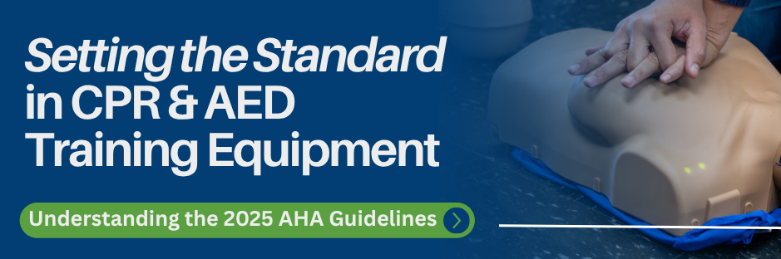


Slide 2
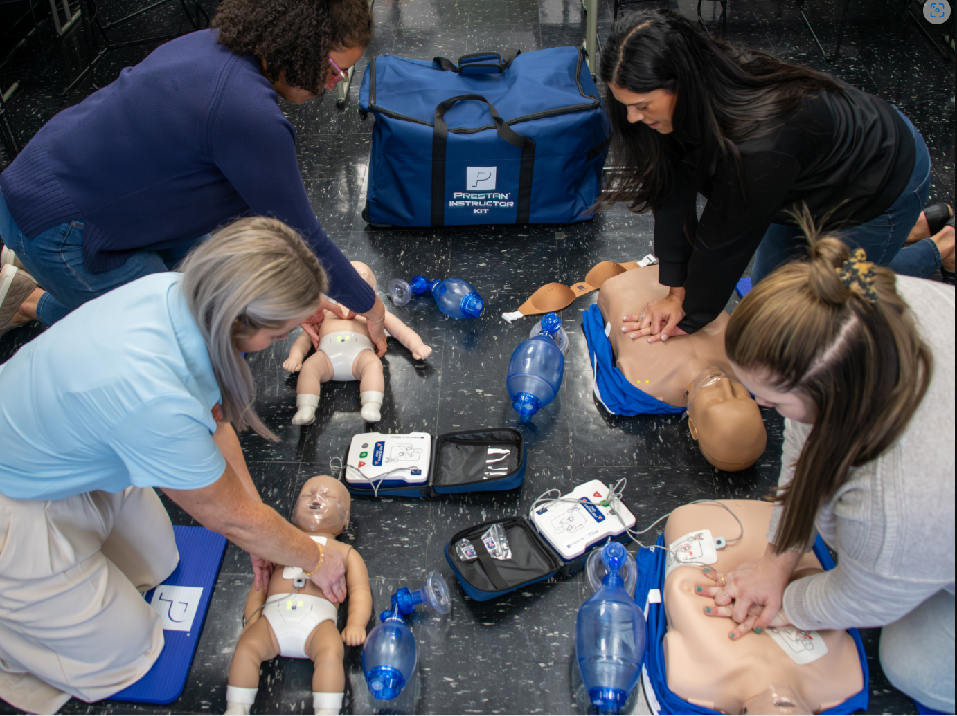


Agenda
PRESTAN Overview
Product Offering
Recent Introductions
AHA Guidelines Update
Additional Resources

Slide 3
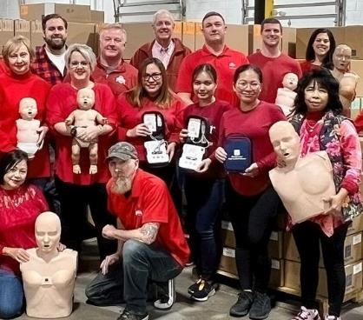
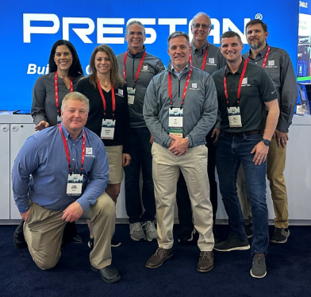
PRESTAN Products Overview
Founded in 2004
Headquarters located in Ohio, USA
Customers in 80+ countries
Design and manufacture PRESTAN CPR Manikins & AED Trainers
PRESTAN products are sold through Authorized Distributors
All CPR Training Manikins are Made In The USA

Slide 4
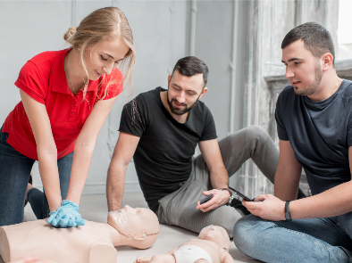

PRESTAN is Committed to Building Confidence…
with Students
provide simple, immediate feedback
realistic CPR training manikin and AED trainer designs
with Instructors
durable, affordable products
easy to setup & clean; compact & lightweight to transport
with Distributors & Sub-Distributors
extension of PRESTAN Sales, Marketing & Customer Service teams
support and enable industry growth through strategic partnership
long term investment in new product development

Slide 5

Product Offering

Slide 6
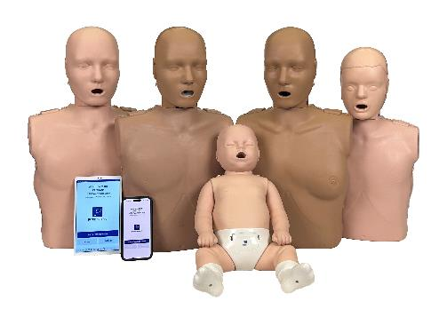
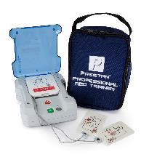
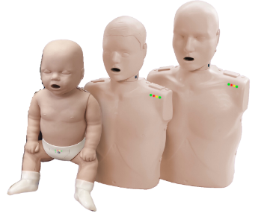
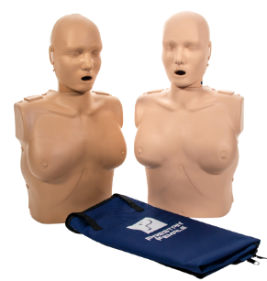
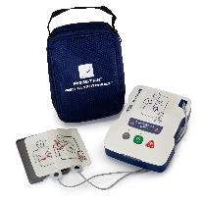
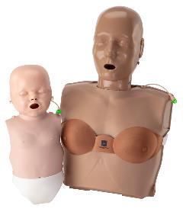
PRESTAN Product Positioning
Advanced
Professional
Features & Benefits
Portable
Basic CPR Training
Advanced CPR Training

Slide 7
PRESTAN CPR Training Manikins
Portable – Ultralite Series
Compact & Lightweight
Easy to Transport and Set-up
Durable & Affordable
New Instructors / Starter Kit
On-the-go / Large-scale Training
1:1 Student to Manikin Ratio
Professional – Professional Series
Fast, Simple Setup / Easy to Use & Clean
Robust, Durable & Reliable
Realistic Design
Gold Standard of Training
Stationary Single Location Training
Ideal for BLS, PALS, Heartsaver
Advanced – Professional Series 2000
Dual Purpose - Basic & Advanced Feedback
Rate, Depth, Recoil, Ventilation, CCF
Up to Six Students Connect to App
Supports Advanced Training at Low Cost
Feedback via PRESTAN CPR Feedback App Elevates Training Experience

Slide 8
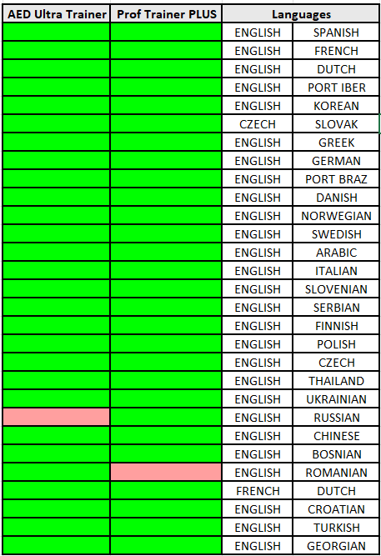
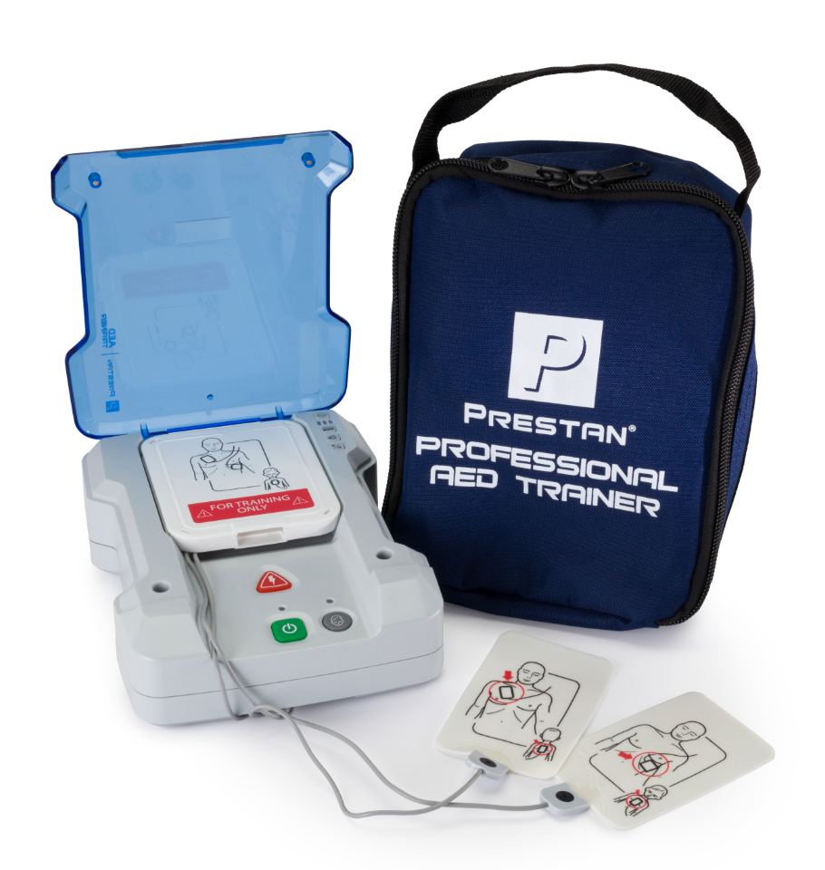
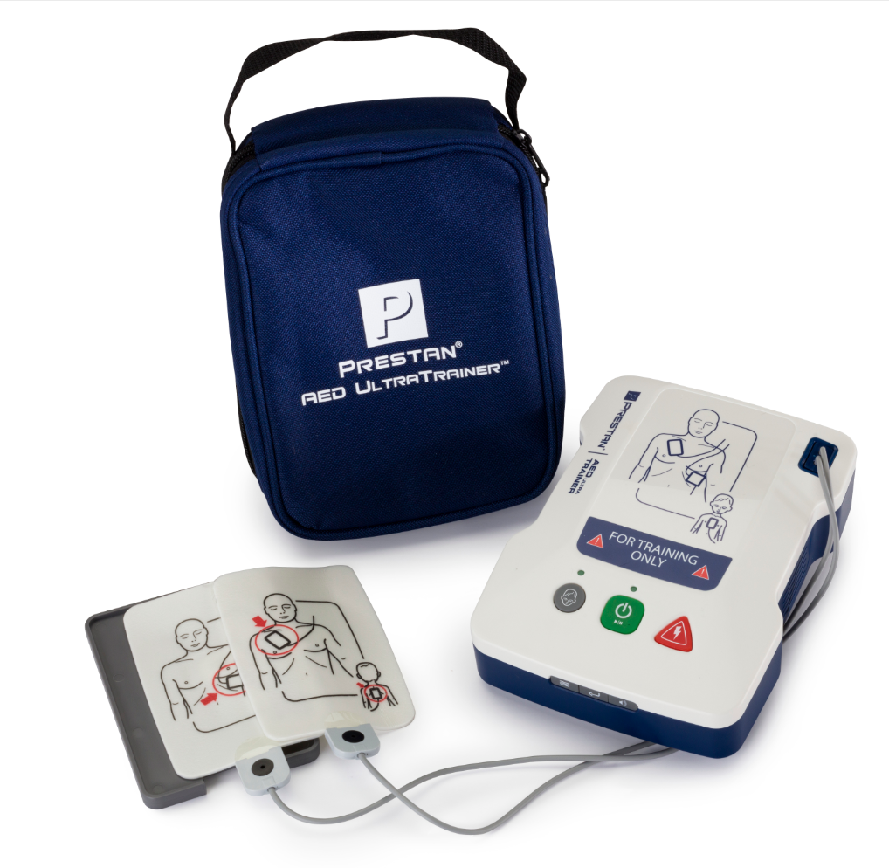
PRESTAN AED Trainers
Portable – AED UltraTrainer
Compact, Lightweight, and Affordable
Customizable w/ Child Button & Dual Language
Robust, Durable & Reliable
New Instructors / Ideal Starter Kit
On-the-go / Large-scale Training
1:1 Student Manikin Ratio
Professional – AED Professional Trainer PLUS
Most Closely Resembles Branded AED Trainers
Customizable w/ Child Button, Dual Language, and Remote (Optional)
Robust, Durable & Reliable
Gold Standard of Training
Stationary Single Location Training
Ideal for BLS, PALS, Heartsaver

Slide 9
Recent Introductions

Slide 10
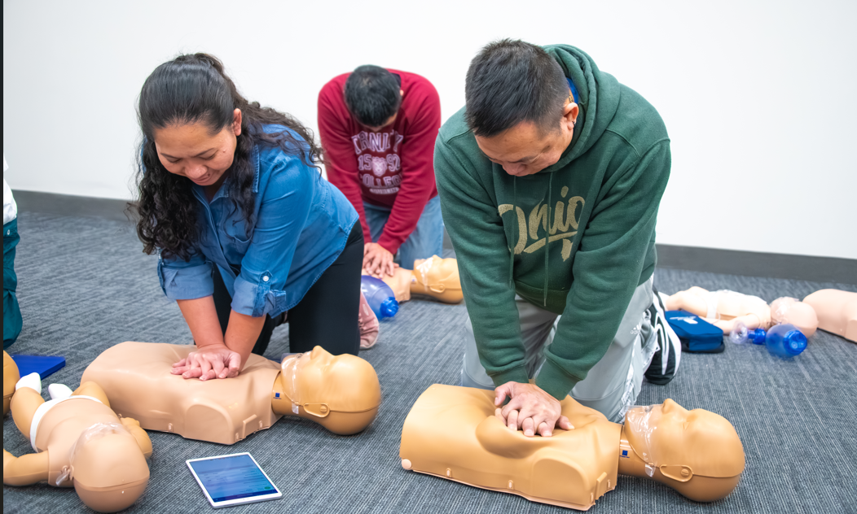
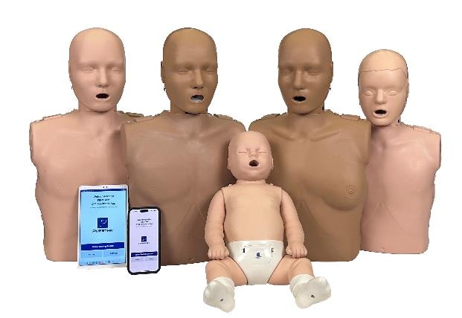
*NEW* PRESTAN Series 2000 Complete Offering
PRESTAN is committed to building confidence with a dual-purpose training solution that offers both basic and advanced CPR feedback; now available with the following PRESTAN manikin designs:
Professional Adult
PRO+
Professional Female
Professional Child
Professional Infant

Slide 11
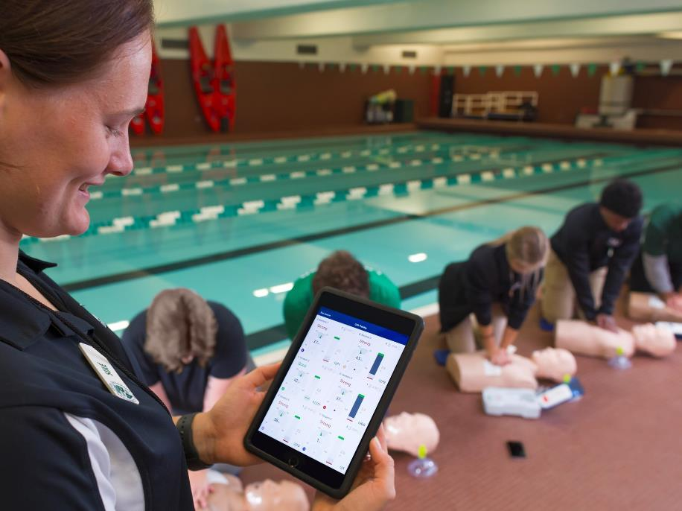
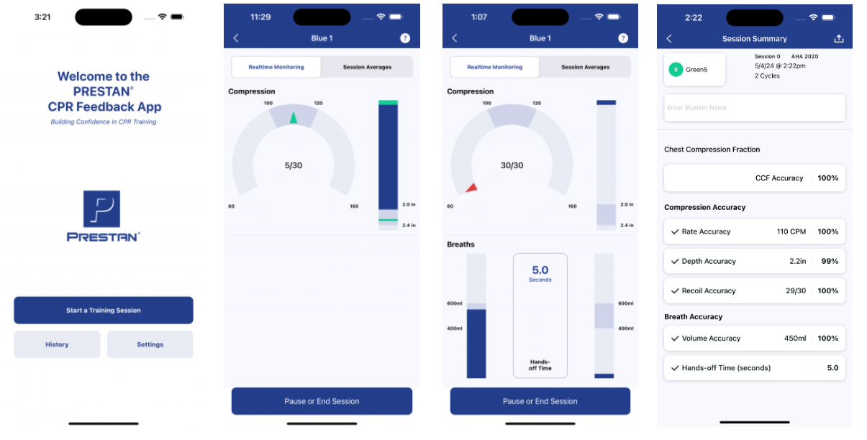
*UPDATED* PRESTAN CPR Feedback App
The new PRESTAN CPR Feedback App provides:
an improved user experience
expanded list of available languages
easier setup - no need to calibrate breaths!
more intuitive CPR feedback - with the addition of chest compression fraction!
ongoing enhancements

Slide 12
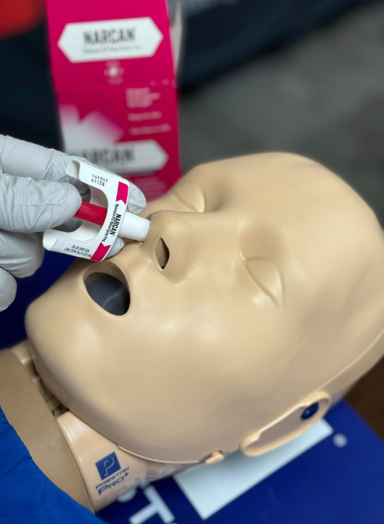
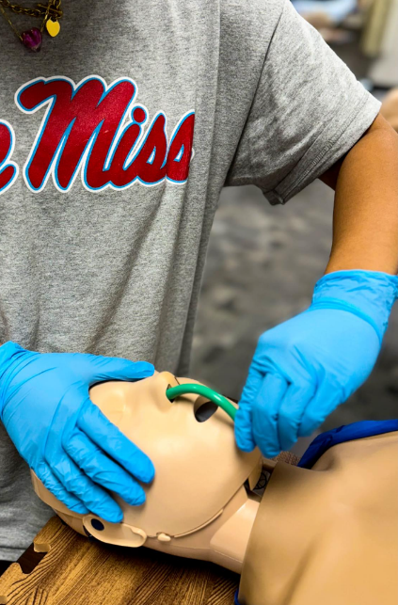
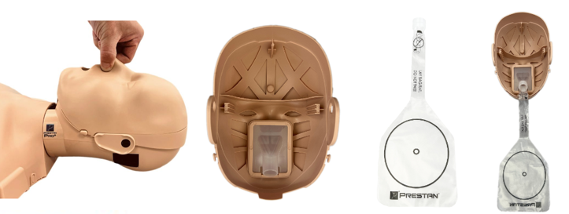
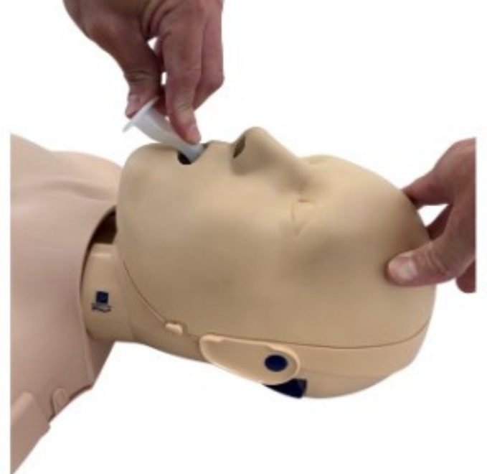


*NEW* PRESTAN PRO+ Manikin
With the introduction of the new PRO+ Adult Head design, PRESTAN is enhancing realism with a functional nasal airway and improved lung bag design along with the ability to use a NARCAN® and OPA/NPA training devices.
Notes:
The PRESTAN Infant Ultralite Manikin is now available.

Slide 13
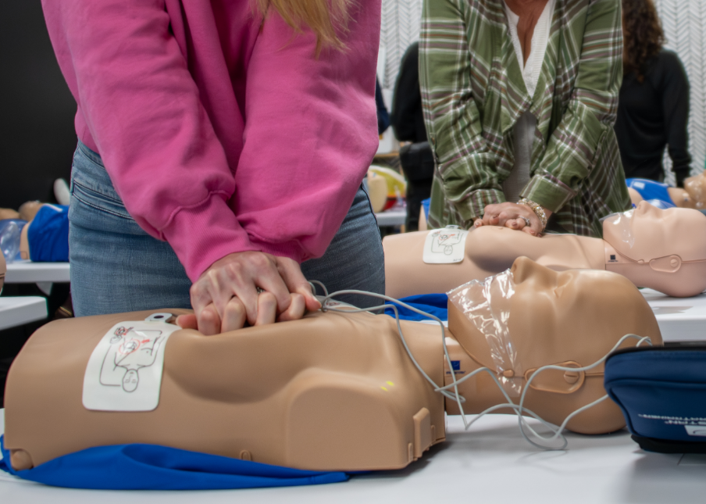
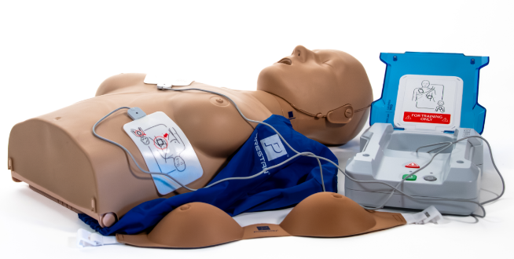
PRESTAN Professional Female Manikin
PRESTAN is committed to building confidence by providing high quality, affordable, realistic training equipment that helps instructors provide a full range of CPR/AED training scenarios.

Slide 14
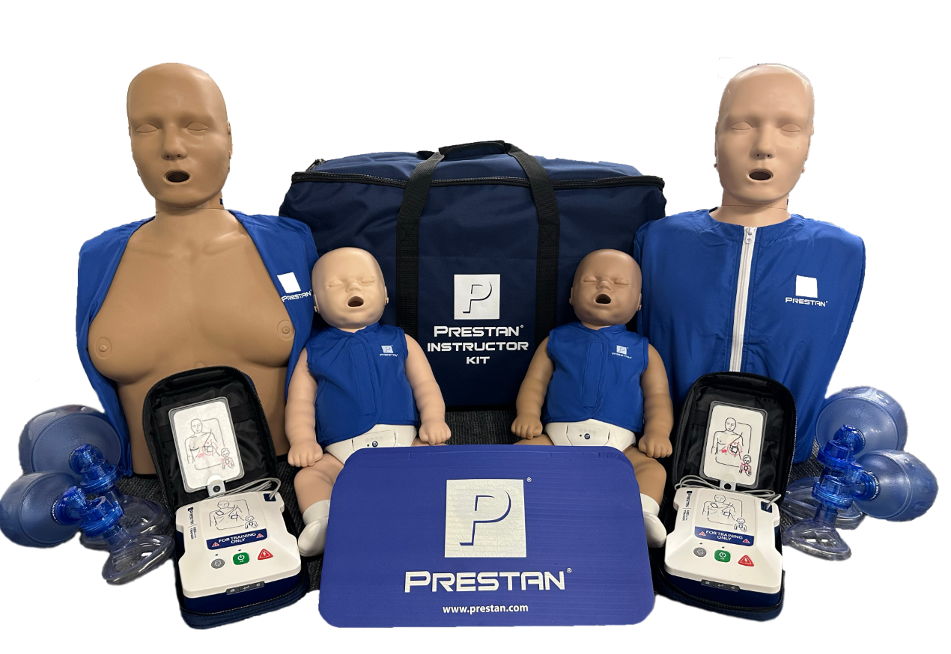
*UPDATED* PRESTAN Instructor Kit
The PRESTAN Instructor Kit combines our most popular manikins & AED trainer along with a collection of CPR training supplies making this an ideal starter kit and easy to transport all-in-one solution for any new or experienced instructor.
NOW WITH PRESTAN
FEMALE MANIKIN!
Notes:
The PRESTAN Infant Ultralite Manikin is now available.

Slide 15
AHA Guidelines Update

Slide 16
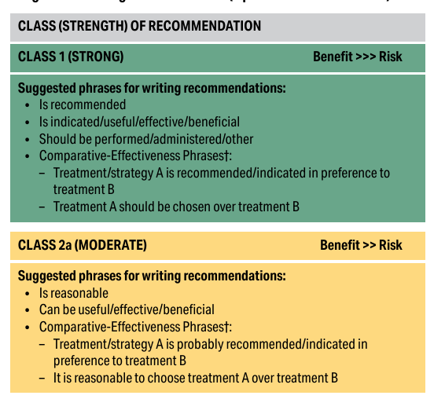
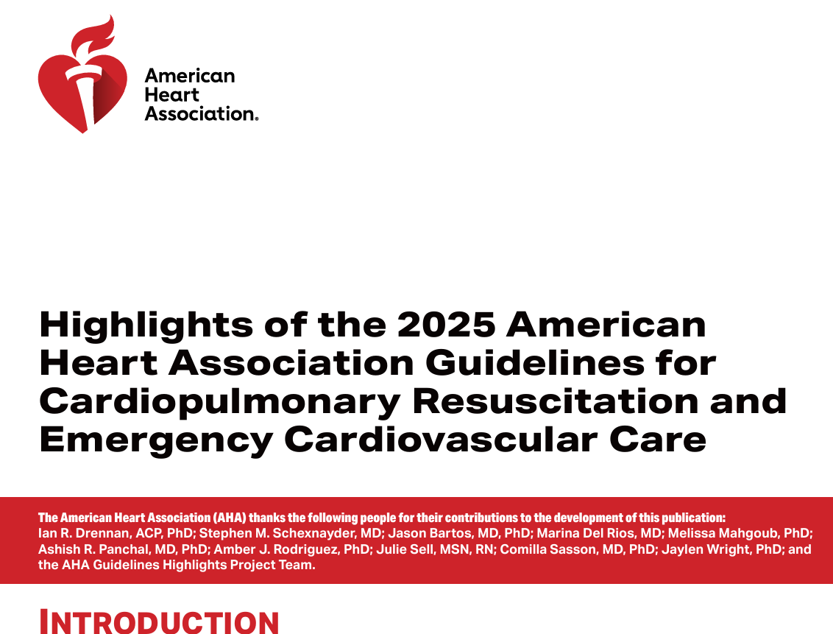
AHA Guidelines Class of Recommendation

Slide 17
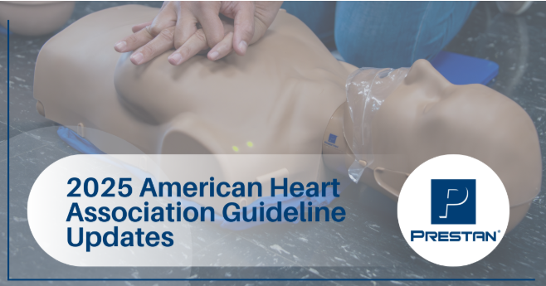
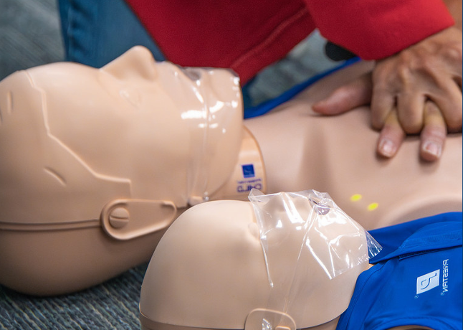
Use of Feedback Devices During CPR Training
Class 1 Strong Recommendation
Feedback devices have been required by AHA for adult manikins since 2017, and the 2025 Guidelines further expand this recommendation for all CPR training equipment, reinforcing the importance of real-time, measurable feedback for high-quality performance.
→ All PRESTAN manikins feature audio (click) and visual (light) indicators — ensuring accurate, measurable compression rate and depth performance. → The PRESTAN Series 2000 line further enhances realism with real-time recoil feedback, providing precise data on compression depth and release.

Slide 18
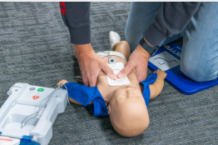
Sequence of Resuscitation for Infants
Class 1 Strong Recommendation
The two-thumb encircling hands and one-hand methods replace the traditional two-finger approach, improving compression consistency and depth.
→ PRESTAN Infant Manikins support both updated techniques with accurate resistance and feedback.

Slide 19
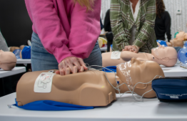
Disparities in Education
Class 1 Strong Recommendation
Studies show disparities in CPR response rates between men and women, highlighting the need for balanced gender representation in training. → The PRESTAN Female Manikin, available in medium and dark skin tones, promotes gender balance and helps address CPR disparities between men and women.

Slide 20
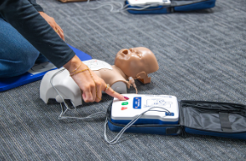
CPR Training in School Children
Class 1 Strong Recommendation
The AHA now recommends introducing CPR training to children younger than 12 years old to help build confidence and willingness to act as future lay rescuers.
→ The PRESTAN Ultralite Manikin offers a compact, lightweight, and affordable solution for large-group or mobile CPR instruction—making it easier than ever to bring lifesaving training to schools and community programs.

Slide 21
Lay Rescuer Willingness to Perform CPR
Class 2a Moderate Recommendation
Promoting Hands-Only CPR through mass training and community initiatives can increase lay rescuer willingness to act in emergencies.
→ The PRESTAN Ultralite Manikin offers a compact, lightweight, and affordable solution for large-group or mobile CPR instruction—making it easier than ever to bring lifesaving training to schools and community programs.

Slide 22
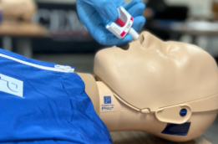
Opioid Overdose Training
Class 1 Strong Recommendation
The 2025 Guidelines expand training guidance for naloxone (NARCAN) use and emphasize lay rescuer readiness. → The PRESTAN PRO+ Head supports NARCAN, OPA, and NPA training devices, helping instructors teach effective opioid overdose response.

Slide 23
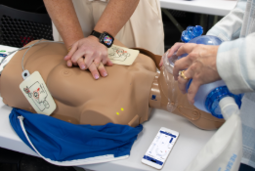
Ventilation
Class 2a Moderate Recommendation
The 2025 AHA Guidelines reinforce the importance of delivering effective ventilations with visible chest rise during adult cardiac arrest.
→ The PRESTAN Series 2000 manikins provide real-time ventilation feedback through the PRESTAN CPR Feedback App, allowing instructors and learners to monitor breath volume — helping ensure ventilations meet guideline recommendations and support high-quality CPR performance.

Slide 24
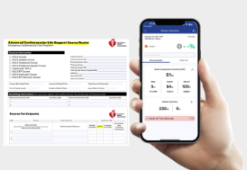
Reporting Chest Compression Fraction
Required on ACLS Course Roster
The 2025 AHA Guidelines now require chest compression fraction to be reported on the ACLS Course Roster, reinforcing the importance of high-quality compressions during resuscitation training.
→ The PRESTAN Series 2000 manikins provide real-time Chest Compression Fraction (CCF) feedback through the PRESTAN CPR Feedback App, allowing instructors and participants to accurately measure and report performance metrics required for compliance.

Slide 25
Additional Resources

Slide 26
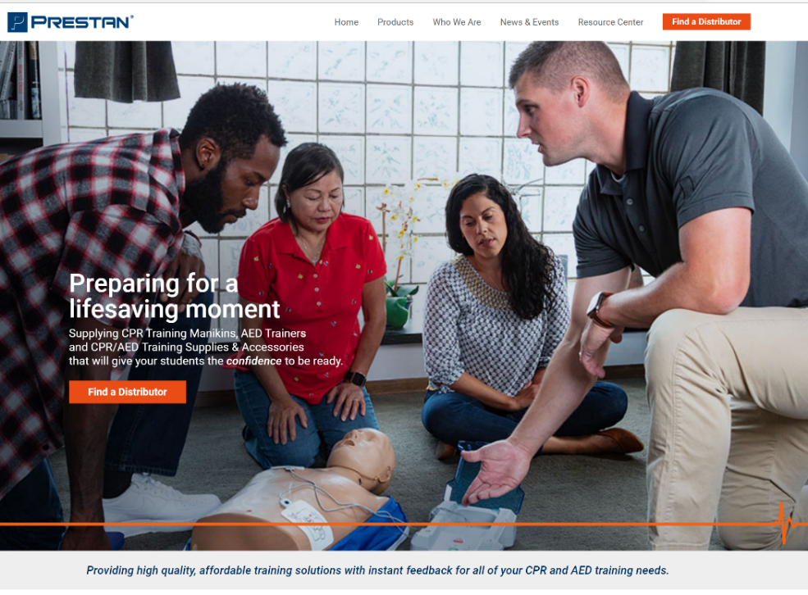
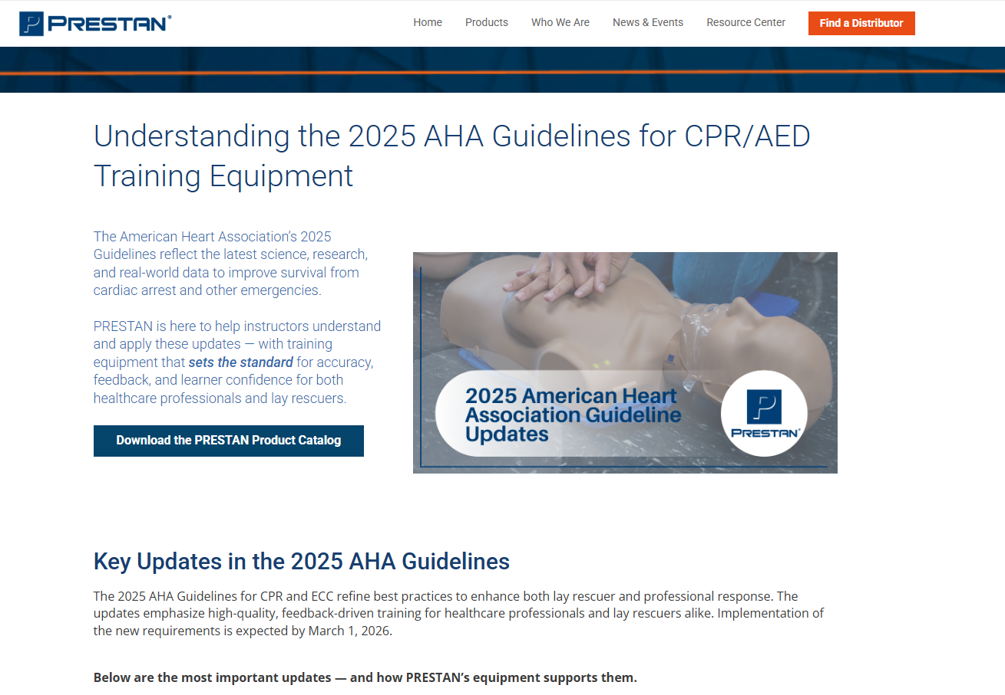
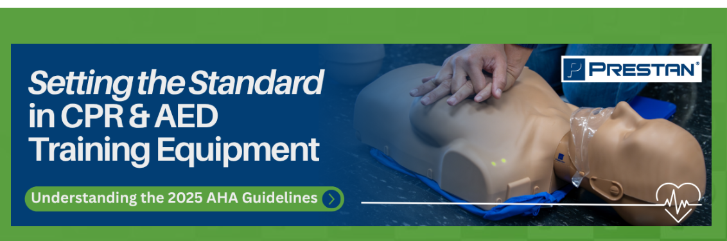
PRESTAN Website & AHA Updates Landing Page

Slide 27
Thank you!

