Slide 1
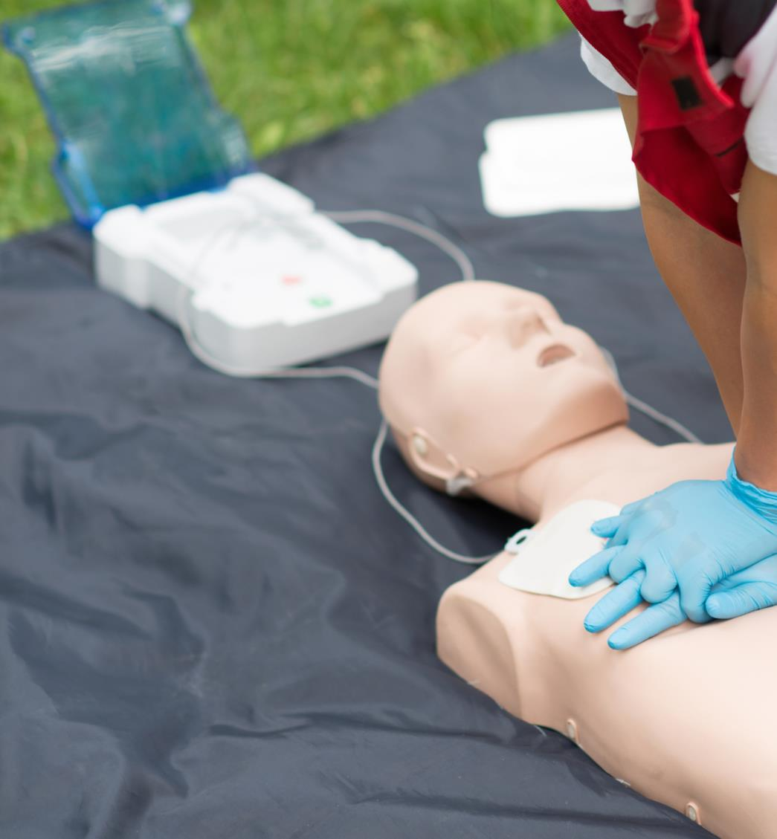

Building Confidence
3/9/2026
Ed Feil – VP, Global Sales & Marketing
Cory Buhrman – Product Manager

Slide 2
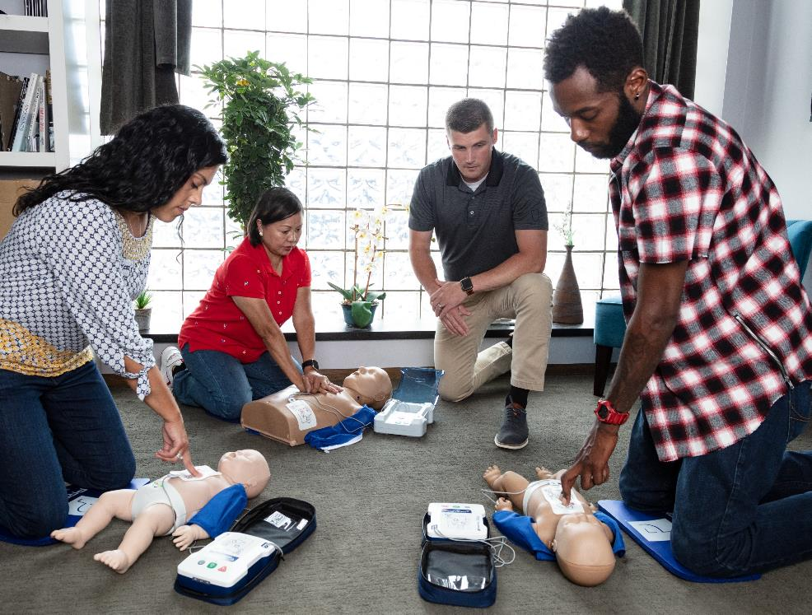


Agenda
PRESTAN Overview
Product Offering
Recent Introductions
Additional Resources

Slide 3
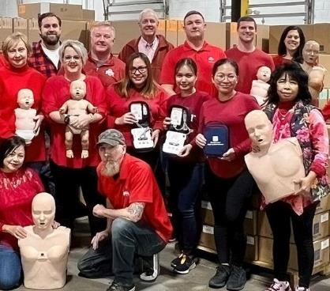
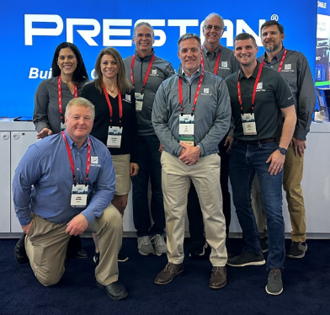
PRESTAN Products Overview
Founded in 2004
Headquarters located in Ohio, USA
Customers in 80+ countries
Design and manufacture PRESTAN CPR Manikins & AED Trainers
All PRESTAN products are sold through Authorized Distributors

Slide 4
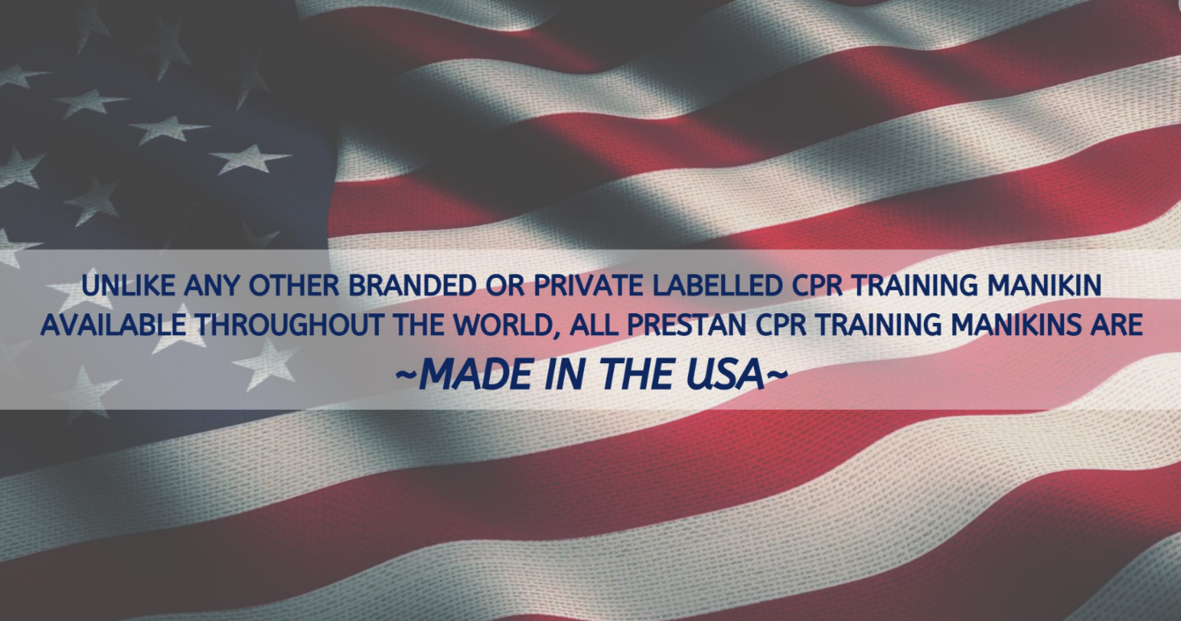
Made / Assembled In The USA

Slide 5
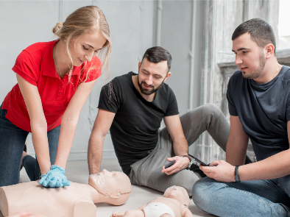

PRESTAN is Committed to Building Confidence…
with Students
  provide simple, immediate feedback
  realistic CPR training manikin and AED trainer designs
with Instructors
  durable, affordable products
  easy to setup & clean; compact & lightweight to transport
with Distributors & Sub-Distributors
  extension of PRESTAN Sales, Marketing & Customer Service teams
  support and enable industry growth through strategic partnership
  long term investment in new product development

Slide 6

Product Offering

Slide 7
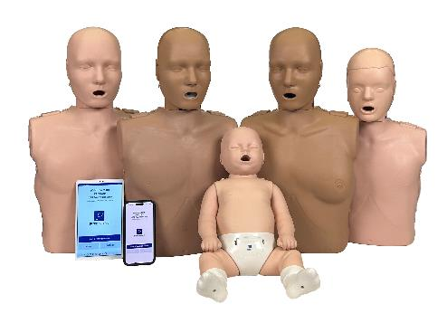
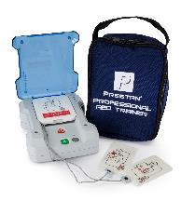
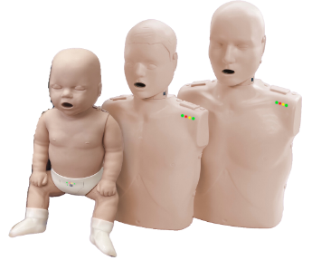
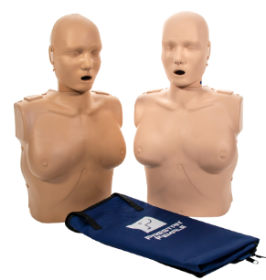
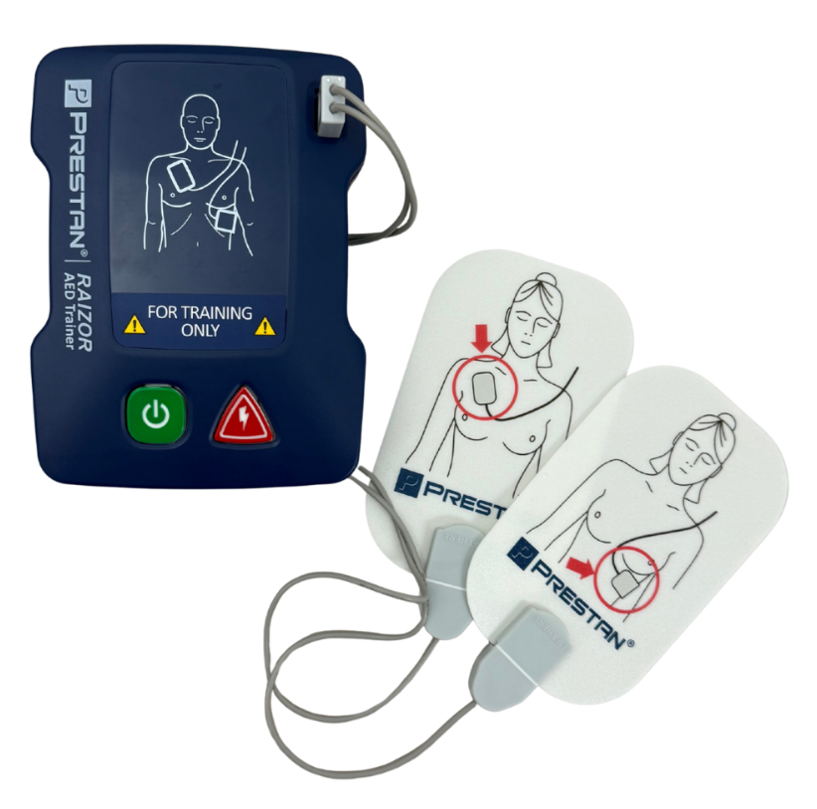
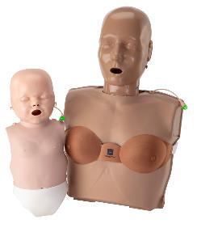
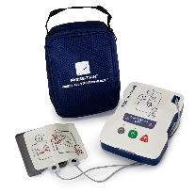
PRESTAN Product Positioning
Advanced
Professional
Portable
Features & Benefits
Basic CPR Training
Advanced CPR Training

Slide 8
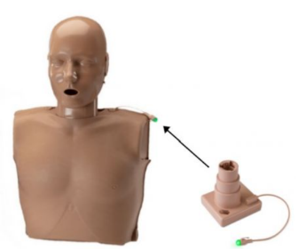
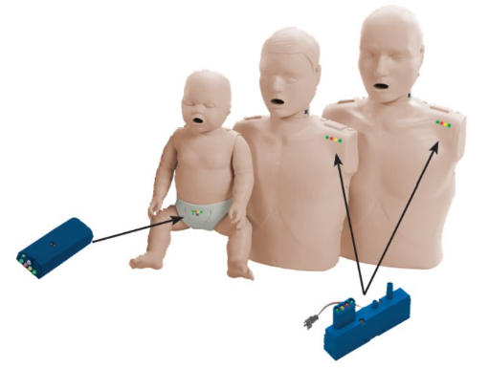
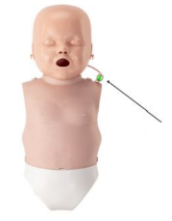
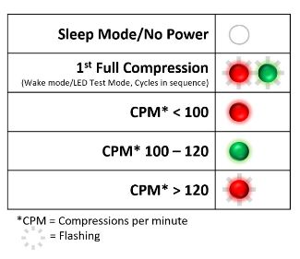
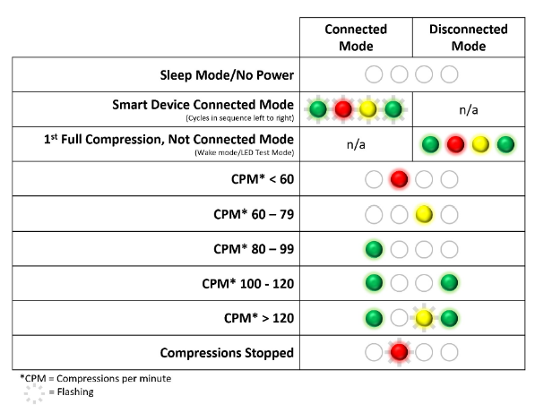
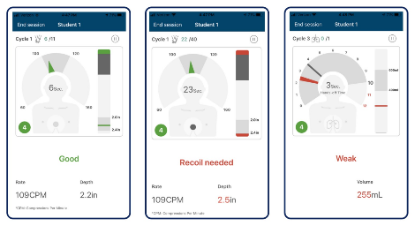
Building Confidence with Feedback…
Ultralite
Professional
Series 2000
N

Slide 9
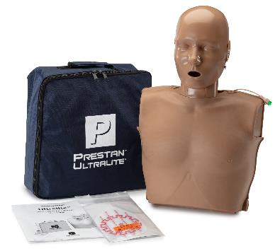
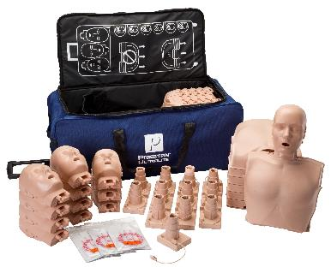
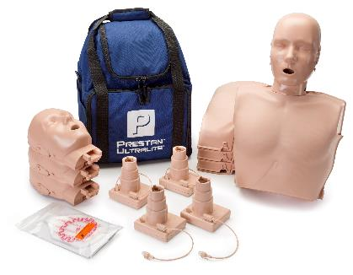
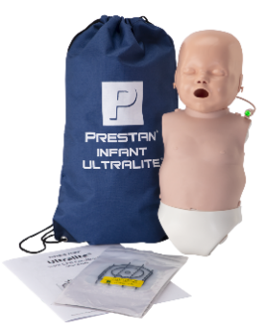
Portable – Ultralite® Manikins
Lightweight and stackable
Simple to set up and clean
Affordable
Skin Tones: Medium, Dark, Diversity
  Single
  4-pack
  12-pack
3-year warranty
N

Slide 10
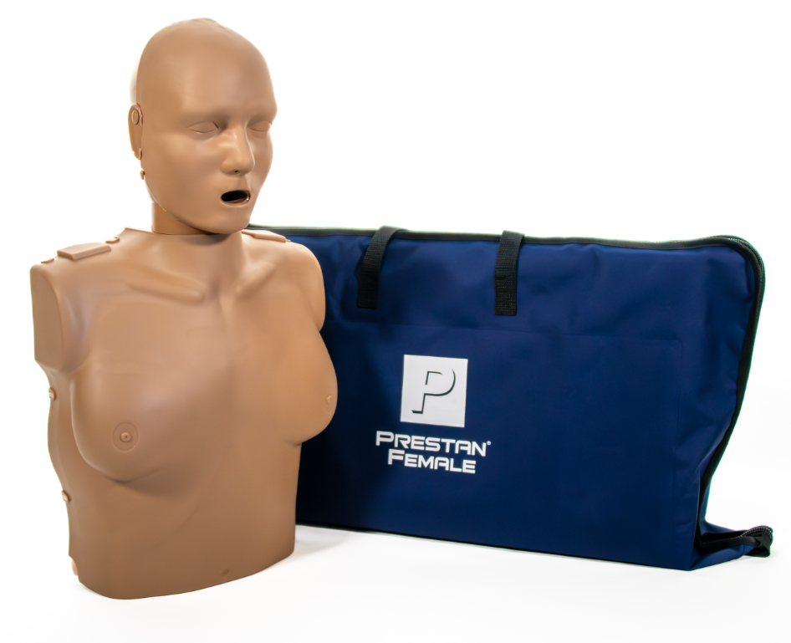
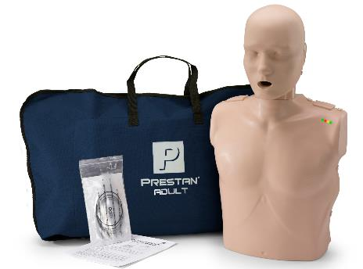
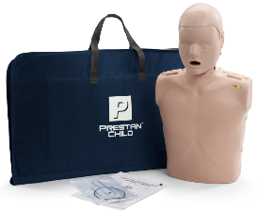
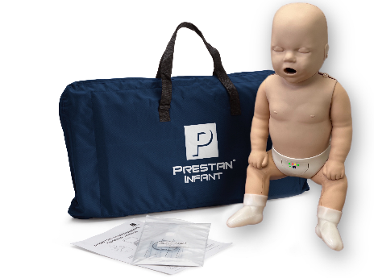
Professional – Professional Manikins
Realistic and anatomically correct design
Durable
Easy to setup and clean
Realtime feedback
Skin Tones: Medium, Dark, Diversity
  Single
  4-pack
3-year warranty
N

Slide 11
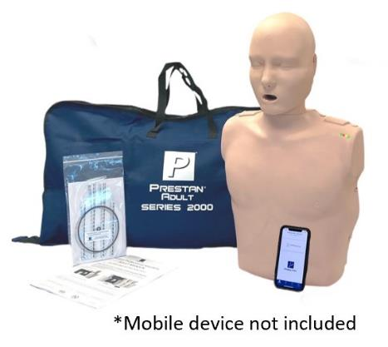
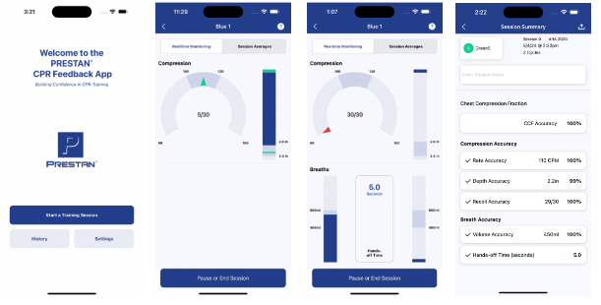
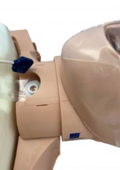
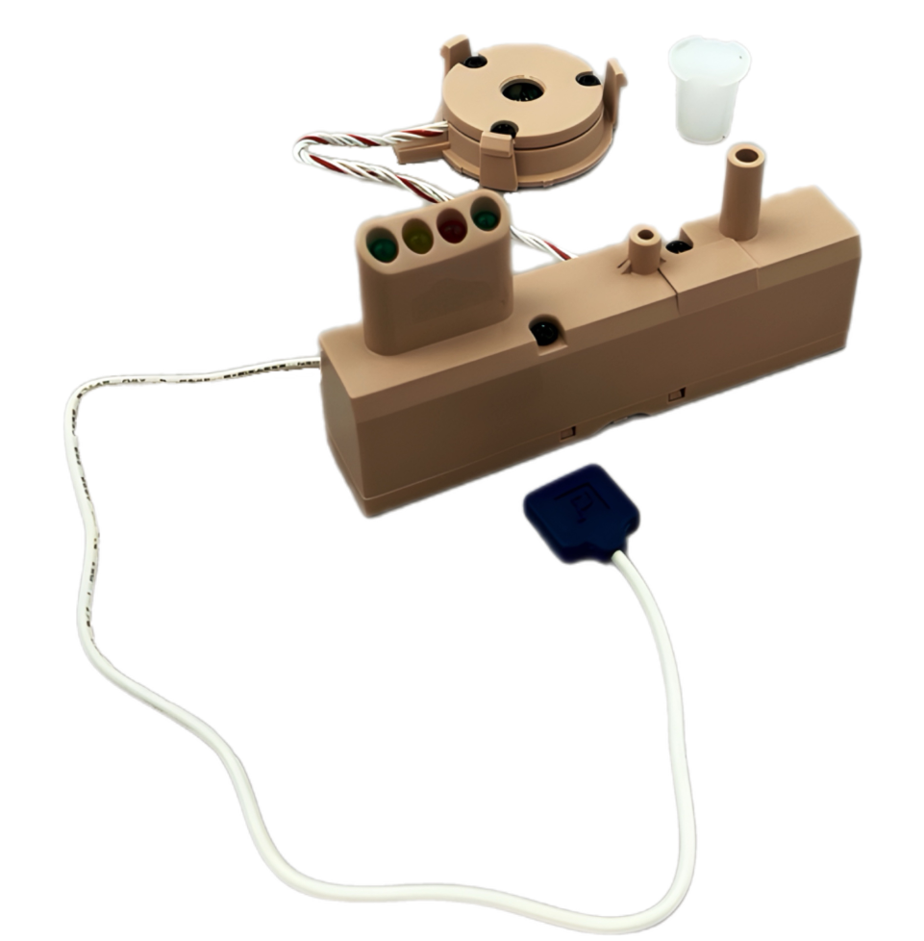
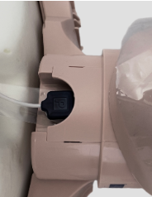
Advanced – Professional Series 2000 Manikins
Dual-purpose training solution
  Basic and Advanced
PRESTAN Bluetooth app
Advanced Feedback
  Rate, Depth, Recoil, Ventilation, CCF
Skin Tones: Medium, Dark, Diversity
  Single
  4-pack
3-year warranty

Slide 12
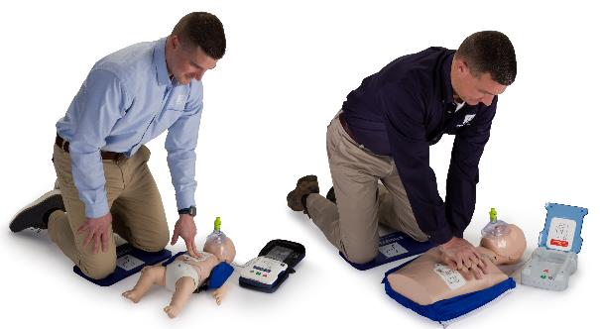
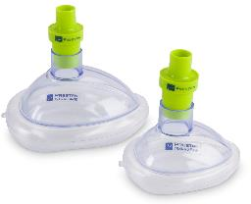
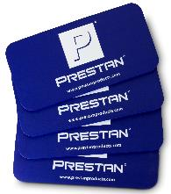
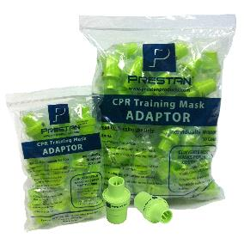
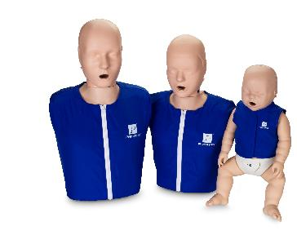
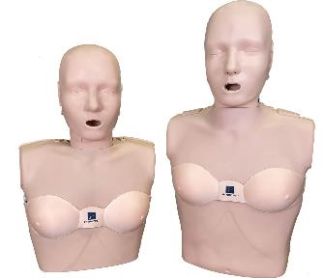
PRESTAN CPR Training Supplies

Slide 13
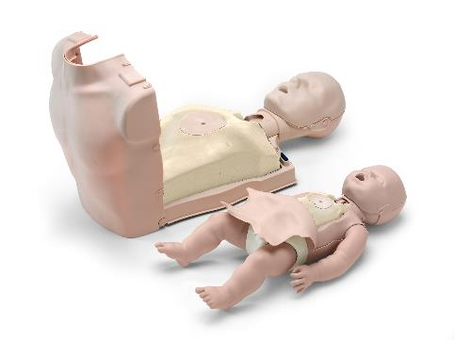
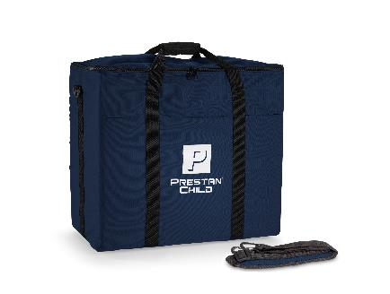
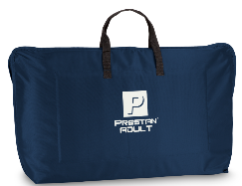
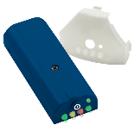
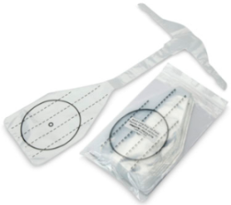
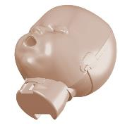
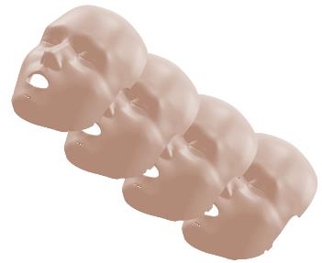
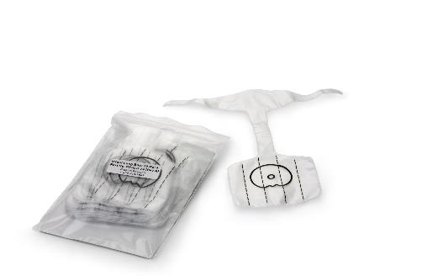
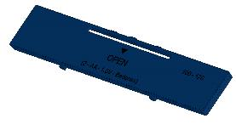
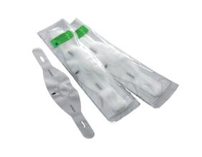
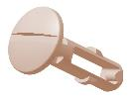
Manikin Parts, Accessories, and Consumables

Slide 14
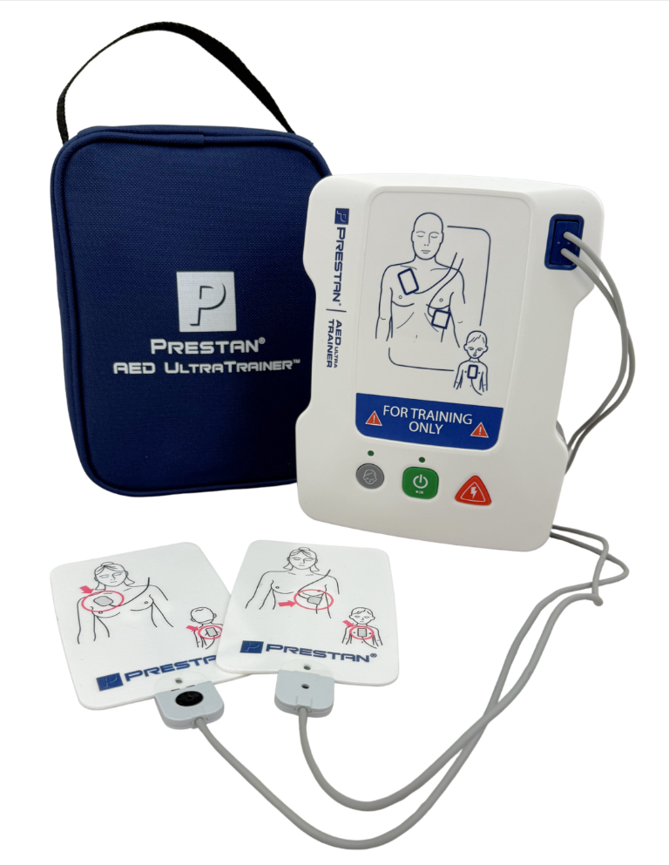




AED Trainer Product Positioning
Portable
Professional
Features & Benefits
PRESTAN AED UltraTrainerTM
PRESTAN Professional AED Trainer PLUS
PRESTAN AED Raizor Trainer

Slide 15


PRESTAN AED Trainer Comparison Matrix

Slide 16
Portable – AED UltraTrainerTM
Simulates live training experience
Customizable to classroom situation
Durable and affordable
Dual language
Pediatric button
Compact and lightweight
Single and 4-pack
3-year warranty
N

Slide 17


Professional – Professional AED Trainer PLUS
Simulates live training experience
Customizable to classroom situation
Durable and affordable
Dual language
Pediatric button
Larger size with lid
Optional remote
Single and 4-pack
3-year warranty
N

Slide 18


*NEW* PRESTAN AED Raizor Trainer
Designed for simple, cost-effective AED training, the PRESTAN AED Raizor Trainer delivers everything instructors need—without unnecessary complexity.
Compact design fits comfortably in the hand
Straightforward instruction
One shock training scenario
Fixed volume level

Slide 19

PRESTAN AED Raizor Trainer Product Demo

Slide 20


Patented AED Trainer Pads Product Features
PRESTAN Pad Sensing System
100 applications
Affordable and simple replacement
Single and 4-pack
N

Slide 21











AED Trainer Parts, Accessories, and Consumables

Slide 22
Recent Introductions

Slide 23


PRESTAN Series 2000 Complete Offering
PRESTAN is committed to building confidence with a dual-purpose training solution that offers both basic and advanced CPR feedback.

Slide 24

PRESTAN CPR Feedback App
The new PRESTAN CPR Feedback App provides:
an improved user experience
expanded list of available languages
easier setup - no need to calibrate breaths!
more intuitive CPR feedback - with the addition of chest compression fraction!
PRESTAN owned technology - allows for ongoing improvements and faster updates!

Slide 25

PRESTAN Series 2000 Product Demo

Slide 26





PRESTAN PRO+ Manikin
With the introduction of the new PRO+ Adult Head design, PRESTAN is enhancing realism with a functional nasal airway and improved lung bag design along with the ability to use a NARCAN® or NPA training device.
Notes:
The PRESTAN Infant Ultralite Manikin is now available.

Slide 27

PRESTAN PRO+ Product Demo

Slide 28


PRESTAN Professional Female Manikin
PRESTAN is committed to building confidence by providing high quality, affordable, realistic training equipment that helps instructors provide a full range of CPR/AED training scenarios.

Slide 29


PRESTAN Instructor Kit
The PRESTAN Instructor Kit combines our most popular manikins & AED trainer along with a collection of CPR training supplies making this an ideal starter kit and easy to transport all-in-one solution for any new or experienced instructor.
Notes:
The PRESTAN Infant Ultralite Manikin is now available.

Slide 30
Additional Resources

Slide 31



PRESTAN Website & Resource Center

Slide 32


PRESTAN Product Guide & Product Catalog
Top 3 Features & Ideal Fit for Product Lines
  Portable – Ultralite Series
  Professional – Professional Series
  Advanced – Professional Series 2000
Recommended Conversation Starters
  What do you do?
  What’s most important to you?
  What frustrations do you have?
PRESTAN Product Catalog

Slide 33
Thank you!

